Slide 1


CAP 2.0
Mark Stewart and Sally DeLeon, Office of Sustainability
Notes:
Intros

Slide 2

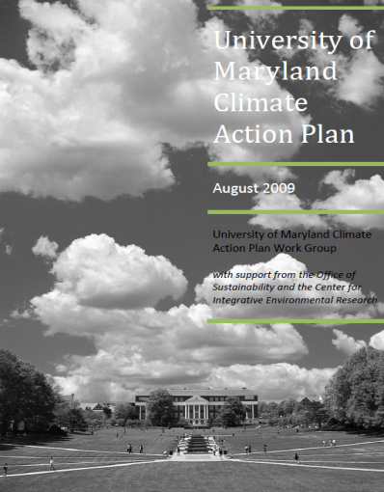
From CAP 2009 to CAP 2.0
CAP 2009
Pros
  Created by large (55+ people) work group
  Lots of stakeholder engagement
  Includes specific, measurable strategies
  President and Senate approved
Cons
  Physical document/PDF
  71 pages
  Doesn’t identify implementation leaders
  Doesn’t specify funding sources
  Hard to track and report progress on individual strategies
  Some strategies are now dated or problematic

Slide 3
From CAP 2009 to CAP 2.0
Dated/Problematic Strategies
LEED Cost/Benefit Analysis – not necessary, LEED became standard practice
Departmental Energy Reports – labor intensive, now trying automated building-level energy reports
Commuting by Public Transportation – no real program behind the strategy
Teleworking – may actually increase emissions, equity issues
No Fly Zone – nobody would enforce it, equity issues

Slide 4
From CAP 2009 to CAP 2.0
CAP 2.0
Website, not a document
  More people will actually look at it
  Simplify the content – show what’s most important
  Dynamic
    Easy to make minor updates to strategies (2.1, 2.2, etc.)
    Easy to show real-time progress on strategies
Identify implementation leaders
Prioritize strategies based on cost and impact
Show clear roadmap for meeting upcoming targets

Slide 5

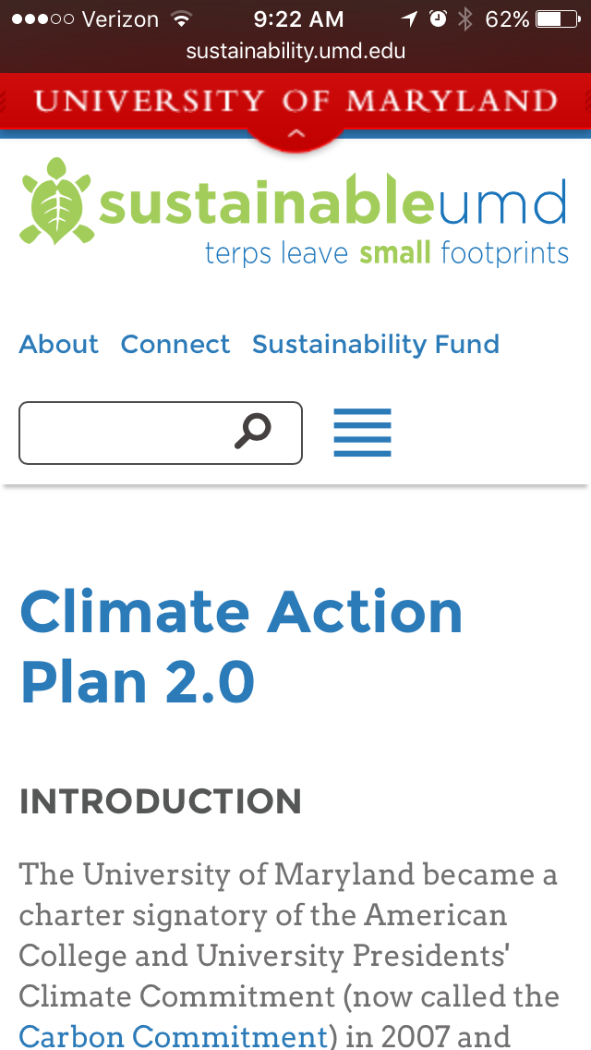
climateplan.umd.edu
Notes:
And that brings us to the new CAP 2.0, which among other things is now mobile!

