Slide 1

The EU General Data Protection Regulation
An Overview

Slide 2
What is it?
Regulation (EU) 2016/679 of the European Parliament and of the Council of 27 April 2016 on the protection of natural persons with regard to the processing of personal data and on the free movement of such data, and repealing Directive 95/46/EC (General Data Protection Regulation)
aka
The EU General Data Protection Regulation
or
EU GDPR
Find the full text of the GDPR at: http://eur-lex.europa.eu/legal-content/EN/TXT/PDF/?uri=CELEX:32016R0679&from=EN
(note the first 31 pages are a preamble)

Slide 3

Scope and Timeline
The EU GDPR goes into effect
May 25, 2018

Slide 4
Scope and Timeline
The EU GDPR covers:
  Processing* of personal data* of data subjects* who are in the EU*, where either
    Processing is performed by controller or processor of the data in the context of activities of an establishment in the EU
      The EU activities/establishment need not be primary place of business for controller/processor
      Data need not be processed in the EU
      E.g. U.S. Universities with branch campus, study center, research facility in the EU
    or
    Controller or processor is not established in the EU but processing activities relate to
      Offering of goods or services to data subjects in the EU
      or
      Monitoring of data subjects’ behavior as far as the behavior takes place within the EU
      E.g. Study, internships, or research by students/faculty in EU, admissions for EU-based students, research incorporating EU datasets, distance learning for EU-based students

Slide 5
Scope and Timeline: Key Definitions
Processing: ANY operations performed on personal data, including
          Collection
          Recording
          Storage
          Consultation
          Organization
          Erasure
Personal Data: relating to an identified or identifiable natural person
  Fully anonymized data IS NOT subject to the EU GDPR
  Pseudonymized data (attribution to a specific person requires additional information) IS subject to EU GDPR
  Sensitive personal data (race/ethnicity/ political views, religious beliefs, genetics, biometrics health, sexual activity or orientation, criminal record) is subject to more stringent regulation under EU GDPR

Slide 6
Scope and Timeline: Key Definitions
Data Subjects: identified or identifiable natural persons
  Students
  Faculty
  Staff
  Third parties (contractors, donors, alumni)
In the EU: located or residing in the EU. Not limited by nationality or permanent legal residency status.

Slide 7

Consequences of Failure to Comply
Very substantial fines, up to
  4% of total worldwide annual turnover or
  € 20 million, whichever is higher
  Enforcement may be judicial or by supervisory authorities set up in Member States

Slide 8
(Relevant) Lawful Bases for Processing
With consent of the data subject
Necessary for performance of a contract
Necessary for legitimate interest of controller/processor
Necessary to protect “vital interests” of data subject or other natural person(s) (i.e., risk to life or safety)
Necessary for compliance with EU or Member State law*
  *this does not include compliance with U.S. or Maryland law

Slide 9
Lawful Basis for Processing: Consent
Consent must be
  freely given,
  specific,
  informed and
  unambiguous
Consent is revocable at any time (but not retroactively!)
Cannot be combined with another basis for processing
Minors (<16; member countries may set lower limit) cannot consent
Processor/Controller must be able to demonstrate consent was obtained
Official guidance on consent can be found at:
  http://ec.europa.eu/newsroom/article29/item-detail.cfm?item_id=623051

Slide 10
Lawful Basis for Processing: Necessary for Performance of a Contract
Potentially applicable to some common university activities
      Payroll processing
      Third party contractors
      Distance learning in EU
      Admissions
      Study abroad

Slide 11
Lawful Basis for Processing:
Legitimate Interest
Identify the legitimate interest in advance
  Should be lawful, specific, and not speculative
  Examples: enforcement of legal claims, fraud prevention, research
  Processing must be necessary for that interest
Weigh interest against fundamental rights and freedoms of data subject
  Strength of interest vs. impact on data subjects
  Proportionality of transparency and measures to protect rights
  Broader public interest is relevant (charitable, scientific, anti-fraud)
  Reasonable expectations of data subject are also taken into account

Slide 12
Lawful Basis for Processing:
Legitimate Interest
Potentially applicable to:
  EU campuses, affiliates, and programs
  Study abroad
  Alumni Relations
  Distance learning
  Websites
  Research
  Procurement

Slide 13
Rights of the Data Subject
Transparency
Access to Personal Data
Rectification of Personal Data
Erasure of Personal Data (“right to be forgotten”)
Restriction of Processing
Data Portability
Objection to Individual Decision-making by Algorithm/Profiling (incl. direct marketing)

Slide 14
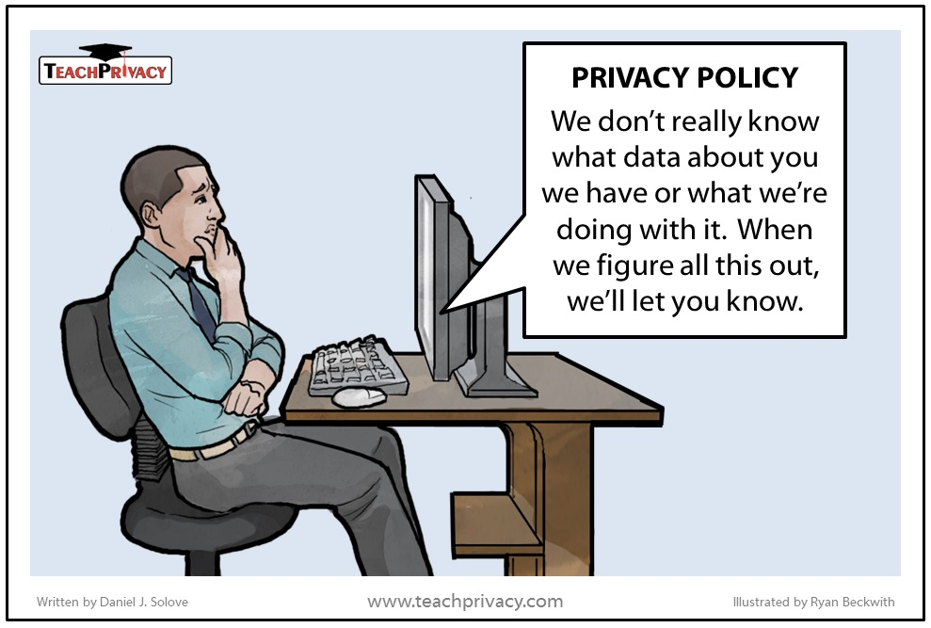
Transparency

Slide 15
Transparency
Privacy Notice must be provided to data subject
  Detailed requirements can be found at GDPR Articles 13 & 14
  Clear and plain language, concise
A couple of potential pitfalls:
  Where data isn’t obtained from the data subject, notice must be given within 1 month, or at the time of first communication with the data subject
  Further processing of data beyond originally disclosed purposes triggers new notice obligation

Slide 16
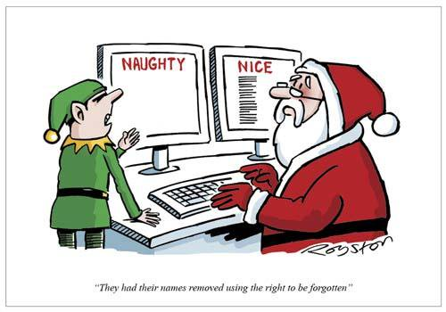
Rights to Rectification and Erasure

Slide 17
Right to Erasure
Right to request erasure of personal data
Applies in limited circumstances
  When lawful processing is complete or was not present to begin with, e.g.
    Research or relationship is concluded
    Withdrawn consent
    Subject objects to “legitimate ground” and balance is held to be in favor of subject
  Data subject is a minor
Exception for “archiving purposes in the public interest, scientific or historical research purposes or statistical purposes”
See more at GDPR Article 17

Slide 18
Compliance Strategy
Identify impacted offices/units and gather information about activities
  Study abroad
  Admissions/International admissions
  Distance learning
  Alumni Relations & Development
  IT
  Researchers/research units acting overseas or using overseas datasets
Revise privacy policies and notices per Articles 13 & 14; develop GDPR-compliant consent form for use as needed, consider whether you need a specialized consent form for sensitive information such as ethnicity and sexual orientation – See Article 9

Slide 19
Compliance Strategy, cont’d
Determine and document bases for processing; note that processing includes storage.
Appoint an EU based representative unless processing is occasional, small scale, doesn’t involve sensitive data, isn’t likely to risk rights and freedoms - see Article 27. Analyze need to appoint a data protection officer as well, if processing is large-scale – see Article 37.
Establish policy mandating recordkeeping of processing activities per Article 30 for any data that is covered by GDPR
  If you appoint an EU representative, that person must also maintain records of processing activities.

Slide 20

Questions? Concerns?

Slide 21
Thank you!
Jennifer DeRose
jderose@oag.state.md.us
410-576-6318

