Slide 1
Exploring Assessment Technologies
MJ Bishop, Director, USM Kirwan Center for Academic Innovation
Sherri Braxton-Lieber, Director, Instructional Technology, UMBC
Jennifer M. Harrison, Associate Director for Assessment, Faculty Development Center, UMBC
Notes:
In this workshop, participants will explore assessment technologies at both the macro (e.g., assessment management systems, e-Portfolio platforms) and micro (e.g., clickers, card swipe technologies) levels through two hands-on activities: (a) the initial development of a taxonomy to make sense of the array of assessment-focused technologies available to institutions and (b) the development of evaluation criteria for judging the appropriateness of a particular technology for use by an institution or a specific division or department. Additionally, the session will focus on the process of identifying and engaging stakeholders at various stages of technology adoption: evaluation/vetting, selection, roll-out, and ongoing use.

Slide 2
Our Learning Outcomes
When we complete this session, we will be able to …
Analyze how technology tools can solve assessment challenges
Classify technology tools and their assessment uses
Develop criteria to evaluate technologies for specific uses

Slide 3
Think-Pair-Share
Why use technology for assessment?
Notes:
Ask audience to answer this question…
Some “prompts”:
Technology can help…
provide timely, relevant learning feedback is essential to personal growth and reflection for student learning.
collect more data to further our understandings on where students are in their learning.
make assessments more effective, informative and maybe engaging too?

Slide 4
Discussion
What assessment problem are you trying to solve?
Notes:
Any technology selection decision MUST begin with clearly articulating the answer to this question.
Ask audience to provide some examples… make sure they’re talking about problems they’re having doing assessments, not problems they’re trying to assess.

Slide 5
Who needs access to the data?
External accreditor (national/disciplinary, regional, state)
USM internal reporting (system, regents)
Institutional senior leadership
Other administrators/staff
College/departmental leadership
Faculty
Students
Notes:
How will you share data with these audiences?

Slide 6
What are you trying to do?
 | Task | Technology | Timing
Collecting
Connecting
Organizing
Archiving
Analyzing
Communicating
What do you need to know about student learning?
What tools could help you find out?
When will you measure? Diagnostic? Formative? Summative?
Notes:
Technology is actually best suited to manipulating data… and it can do it faster and bigger than we are typically capable of doing otherwise.
Specifically, it can help us with (talk through each):
Collecting
Connecting
Organizing
Archiving
Analyzing
Communicating
What are some examples of tools you can think of in each category?

Slide 7
At UMBC …
 | Task | Technology | Timing
Collecting
Connecting
Organizing
Archiving
Analyzing
Communicating
Notes:
Technology is actually best suited to manipulating data… and it can do it faster and bigger than we are typically capable of doing otherwise.
Specifically, it can help us with (talk through each):
Collecting
Connecting
Organizing
Archiving
Analyzing
Communicating
What are some examples of tools you can think of in each category?

Slide 8
Where in the assessment process?
Diagnostic?
Formative?
Summative?

Slide 9
What is the nature of the data?
Quantitative?
Qualitative?
A mix of the two?

Slide 10
What is the “unit” of measure?
Learner (macro)
Institution
College
Department
Program
Learning (micro)
Course
Assignment
Concept/competency
Continuous/real-time
Notes:
What are some examples of tools you can think of in each category?

Slide 11
Triangulating & Using Data
Learning Analytics Data
Learning Outcomes Data
Demonstrate Mission
Notes:
After we take a short break, we’ll discuss how technology can help to connect macro and micro data. When you triangulate these data, you more effectively demonstrate how your institution is achieving its mission.

Slide 12
Choosing Assessment Technology Tools
Focus on Common Ground
Use Backward Design
Take Inventory

Slide 13
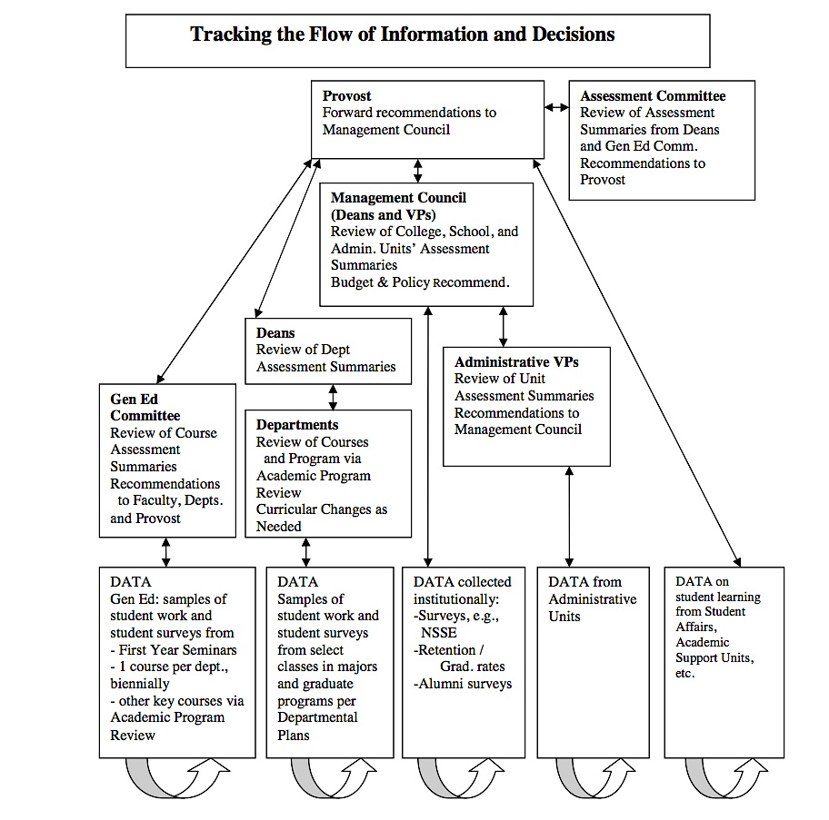
Focus on Common Ground
UMBC’s Assessment Plan
Notes:
First, let’s talk about the role of Common Ground in learning assessment, which is at the heart of technology planning. Here is the diagram from UMBC’s Assessment Plan, which demonstrates how information flows. {click to show diagram}
We need to collect authentic evidence from multiple sources. {click for red brackets} The evidence need to be collected and aggregated and analyzed at multiple levels, as the middle of the diagram suggests.
{Click for red star} The provost needs to collect and connect ALL of these data. That’s why we need to clearly establish common ground. If we want multiple audiences to use these data in multiple ways to improve student learning, then we need flexible (probably multiple) tools to help us.
Let’s look at this in another way.

Slide 14
Document Common Ground By Aligning Institutional, Program, and Course Outcomes
Institutional-Level & General Education Outcomes
Course-Level Outcomes
Course-Level Outcomes
Program-Level Outcomes
Course-Level Outcomes
Course-Level Outcomes
UMBC’s Mission
General Education Committee
The UMBC mission defines student learning goals broadly.
The institutional-level and general education learning outcomes, or Functional Competencies, express these outcomes in five cognitive skill sets.
These general, transferable skills become more focused and particular when expressed in program-level learning outcomes.
Outcomes are even more specific in course-level and assignment outcomes.
Notes:
When you document common ground by aligning from assignment to course to program to institution, you can begin to roll up program assessment to the institutional level.

Slide 15
UMBC’s Mission
FC 1: Oral and Written Communication
OUE/FYS SLO 1 Communication
FYS 102 SLO 1: Communicate
Service Learning Project
Service Learning Project
FYS 102 SLO 3-5: Synthesize Social Justice resources
OUE/FYS SLO 5-7 Literacy, Resilience, Integrative Learning
FC5: Information Literacy
Service Learning Project
FYS 102 SLO 2: Analyze systems
OUE/FYS SLO 3 Analysis
FC 3: Critical Analysis & Reasoning
Notes:
But learning actually takes place at the assignment level, so we need a way to trace direct measure data from the assignment to the course to the program and then to institutional-level outcomes and the mission.
Once the relationships have been defined, you can more effectively prepare for backward design.

Slide 16
Backward Design
What direct evidence do you need to understand student learning?
Notes:
When FDC staff work with faculty on course design, we teach them about backward design, or beginning at the end with the outcomes. What do you want students to be able to learn and do once they complete the course?
This version of backward design requires us to take a couple of additional steps back, to clarify how a course supports program and institutional outcomes. {click}
Before you explore software options, we suggest you consider the types of evidence you will need. Think about the audiences who need to use the data and how they might use it. This is particularly important for direct measure data, because it can be more difficult to use.
In this example, {click} faculty measured student writing skills using a common rubric across 5 writing intensive courses. Faculty hypothesized that students need more practice in writing before they reach these 300-level courses. {click} And these data do suggest that students have room for growth. Plus, we can connect these data with data from other programs to analyze how well students are demonstrating learning in {click} UMBC’s Functional Competency 1, or Written and Oral Communication.

Slide 17
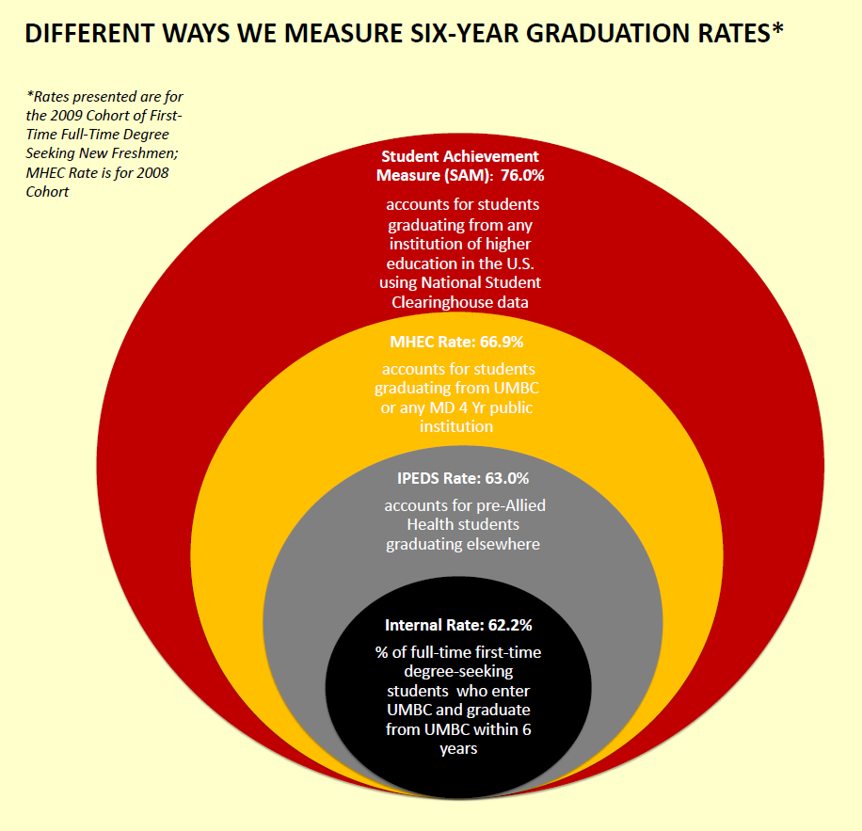
Backward Design
What indirect evidence do you need to understand student learning and success?
Notes:
What if we wanted to look more closely at the relationship between retention and writing intensive courses?

Slide 18
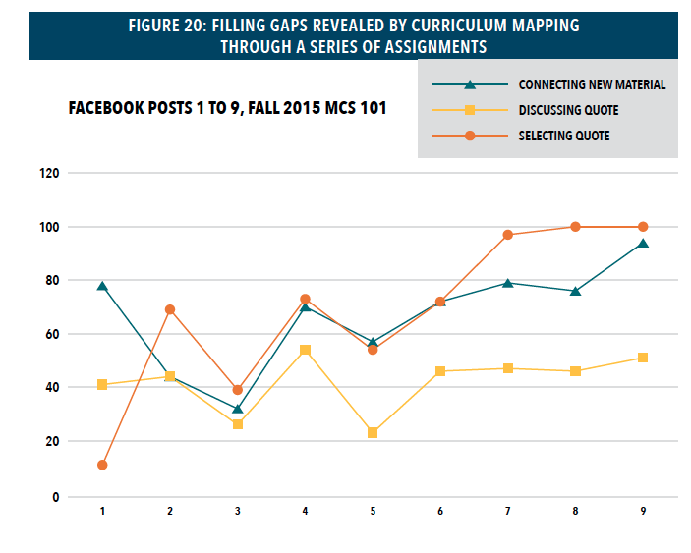
Notes:
Or maybe you want to know if an intervention is working. In this example, we measured student learning in a repeated assignment to find out if it was building information literacy skills. The assignment data confirmed that the series of assignments is working. Since the course itself is an intervention designed to improve learning in the program, we can roll up the data to the program level to determine if it worked. Since we’ve aligned the assignment to the institutional-level outcomes, we can also roll up the data for institutional insights.
Once you’ve spent some time thinking about the kinds of data you need to share, consider taking inventory. What processes and technology tools are already in place at your institution?

Slide 19
Take Inventory: What’s Already Being Used?
At UMBC, we already had tools for …
Analytics
REX
A4L
Outcomes
Blackboard and Blackboard Outcomes
Qualtrics
Clickers
Scantron
Excel, PowerPoint, Word
Notes:
Our data warehouse collects a rich variety of data, allowing UMBC to

Slide 20
Take Inventory: What’s Missing?
At UMBC, we needed tools to …
Link Learning Analytics Data to
Formed a Working Group to Explore
Student Learning Outcomes Data, so we

Slide 21
Take Inventory: What’s Missing?
At UMBC, we need tools to …
Align Direct Measures to Outcomes and
Piloting EAC Visual Data
Aggregate Rubric and Test Data, so we are

Slide 22
Assessing Technology Tools
Criteria | Questions to Consider
Usability | Does the software attempt to encode current best practices in assessment? Can it manage multiple levels of assessment? Is the software intuitive and easy to use? (Will users need extensive training?) Does it work well with software you already have (and are using)? Does it require additional steps/staff to enter and extract data? Does it make assessment feel like an add-on? Or does it make assessment work part of the teaching and learning process? Is the software flexible enough to grow to meet your needs? Does data export in a useable format?
Notes:
Now that we’ve thought about common ground, backward design, and taken inventory, let’s turn our attention to the criteria we could use to identify effective software solutions. We thought of a few things to get started—I’m sure you’ll have plenty of ideas to add.
First we looked at usability. How easy is the software to set up and use?
What other questions do you have? (Add to flip charts)

Slide 23
Assessing Technology Tools
Criteria | Questions to Consider
Cost | How much is the annual software license? Are updates included? How much will it cost for Instructional Technology support and training? What hardware/cloud costs are needed to support it? What hidden costs might emerge?
Audiences | Can the software serve the multiple levels of audiences that authentic assessment requires? Who will need to use this software? How will they learn to use it? Can users interpret the results easily? Can the software provide custom and ready-made reporting tools so you can ask a range of action research questions?
Notes:
We also thought about cost and audience.
If time allows, work with your group from earlier to identify additional criteria and questions to consider.

Slide 24
Assessing Technology Tools
What Criteria Would You Add? | What Questions Would You Add?
Notes:
We also thought about cost and audience.
If time allows, work with your group from earlier to identify additional criteria and questions to consider.

Slide 25
Questions?
Thanks for joining us today!

