Slide 1
Graduate Education Toward a Culture of Assessment
Janet DeLany, DEd
Dean of Graduate Studies
Towson University
Erin Golembewski, PhD
Senior Associate Dean Graduate School
University of Maryland Baltimore

Slide 2
Assumptions
Core to a culture that values graduate assessment are faculty and administrators who:
Appreciate its worth for promoting excellence within and across programs
Acknowledge its necessary for accreditation and funding
Accept its complexity and resource allocation demands
Core to using assessment data for improving graduate programs are processes and tools that:
Promote efficiencies and integrate data collection procedures for multiple purposes within programs and across levels
Facilitate deep analysis of large data sets
Incorporate feedback loops for assessing the utility and meaningfulness of the assessment process

Slide 3
Questions for Reflection
What processes advance a culture of assessment and engage faculty and administrators in that culture?
What, if any, overarching structures should we implement to integrate the graduate education data collection and analysis processes across programs and university units? How will these processes interface with program specific accreditation?
What centralized/decentralized approval processes improve/hinder the assessment process and influence how programs meet at least the minimum university standards for assessment?
What data do we hope to obtain from the assessment process and how might we use that data to advance learning?

Slide 4
Case Study 1: Building a Culture of Assessment- UMB
University of Maryland, Baltimore
Seven Schools, one university
Accreditation for many programs but not all
Strong focus on research achievements

Slide 5
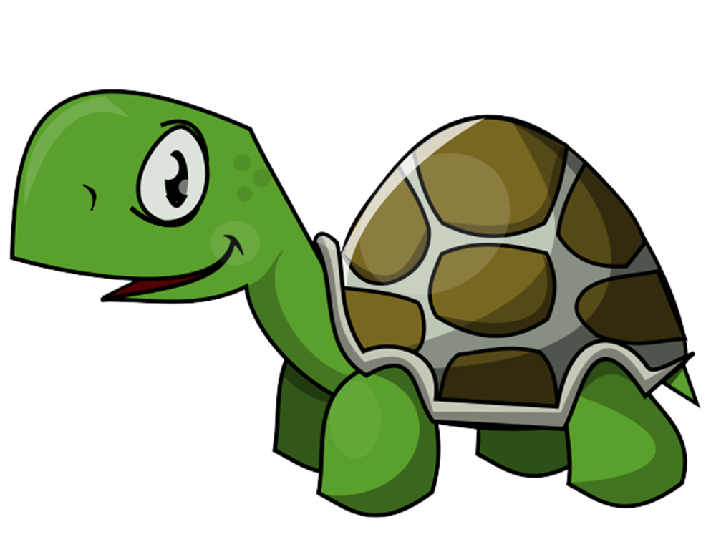
Case Study 1: Building a Culture of Assessment- UMB

Slide 6
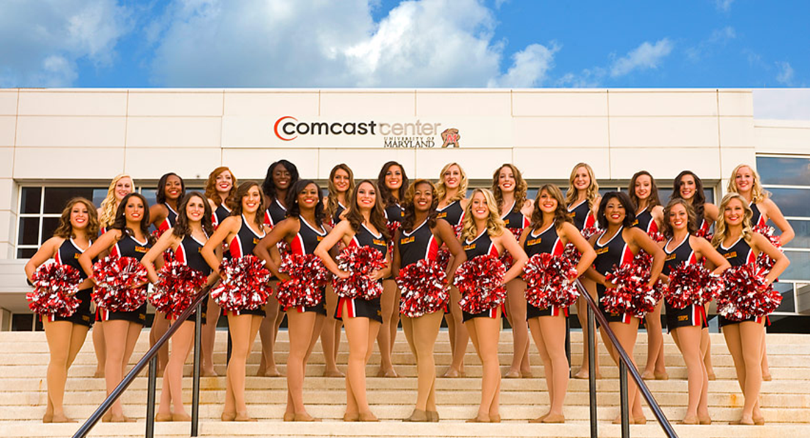
Case Study 1: Building a Culture of Assessment- UMB

Slide 7
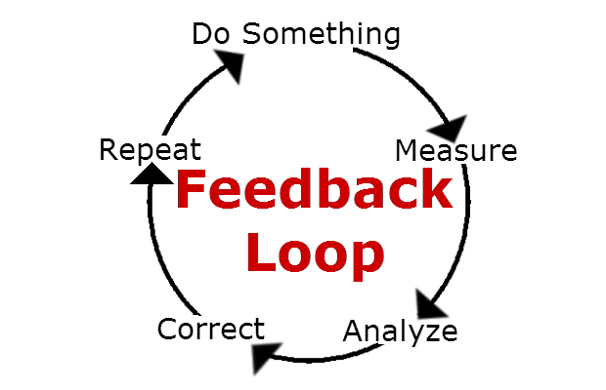
Case Study 1: Building a Culture of Assessment- UMB
https://www.pinterest.com/ggarcia2015364/feedback-loop/

Slide 8
Case Study 1: Building a Culture of Assessment- UMB
Building a culture of assessment
Make assessment a core element of program
Recognize disciplinary differences
Meet faculty where they are
Create opportunities for conversations
Provide resources
Provide faculty development opportunities
Cultivate leadership
Maximize transitions
Start with foundational courses
Use accessible language
Treat it like a research question
Use Backwards design
http://www.learningoutcomesassessment.org/Presentations/AI%20Cain%20and%20Hutchings.pdf

Slide 9
Case Study 2: Using Assessment Data for Graduate Improvement- Towson University
Initiating an assessment plan- SLO connected to University mission and strategic plan
Developing the proposal
Obtaining approval
Implementing the plan- an iterative process
Participating in the yearly reporting cycles and formative feedback loops
Building information for seven year assessment and accreditation reports
Assessing the assessment process

Slide 10
Seven Year Academic Program Review Process- formative and summative processes
Developing the report
Assessing inputs, processes, and outcomes related to faculty, student, curriculum, staff, resources
Developing a comprehensive plan for the future
Obtaining approvals
Program Accreditation reports
Integrating accreditation reports with Seven Year Academic Program Review Process-
Overlaps and distinct features
Middle States standards
Assessing student learning- standard 3
Assessing the assessment process- standard 5

Slide 11
Assessment Process-
Directive
Generative
Uniformity
Central Control
Inter-unit Consistency
Summative
Individualized Applicability
Program/Unit Control
Unit Specificity
Formative
vs.

