Slide 1
Roaring Towards Digital Accessibility
USM Digital Accessibility Transformational Seminar
October 6, 2023

Slide 2
Introduction
USM Concurrent Session, Co-facilitators
Teresa Valais, Sr. Instructional Designer
Faculty Academic Center of Excellence at Towson, (FACET)
tvalais@towson.edu
Brian Williams, Digital Accessibility Analyst
Office Of Technology Services, (OTS)
bwilliams@towson.edu
Notes:
Teresa

Slide 3
Presentation Outline Defining digital accessibility Designing courses with accessibility in mind Campus wide accessibility efforts Projects relating to Digital Accessibility Baking accessibility into Office of Technology processes Next Steps for advancing digital accessibility at Towson University
That's a lot to take in. Let's observe a graphic to help establish some more clarity.

Slide 4
Supplemental Graphic

Slide 5
Checkpoint
"What is happening right now?"
"This presentation has not been great so far.."
Valid Thoughts!
Notes:
Brian
Based on our presentation so far, you may have some thoughts or questions in your head.
Questions like, “What is happening right now?”
Thoughts such as, “This has not been a great presentation so far”
Both are valid thoughts!- and I thank you for bearing with me through that portion of the presentation.
The truth is, without intentional design, we could be subjecting our students to an experience a lot like what we just went through. Confusing, lack of clear structure, and supporting information that only serves to add to the confusion.
In our presentation today, we’re going to speak about intentional steps we’ve been taking at Towson University to support our goal of Roaring Toward Digital Accessibility in the lens of course design, faculty development, and technological infrastructure.

Slide 6
Checkpoint
Characteristics of our introduction:
Confusing
Lack of clear structure (no clear heading, no bullet points)
Wall of indiscernible text
Supplemental graphic that only serves to add to the confusion
Without intentional accessible design, we could be subjecting our students to an experience analogous to this.

Slide 7
Presentation Outline
Defining digital accessibility
Designing courses with accessibility in mind
Campus wide accessibility efforts
Baking accessibility into Office of Technology processes
Next Steps for advancing digital accessibility at Towson University
Notes:
Brian – let's rewind this and see how accessible structure can assist in creating clarity for everyone.
Here is a more structured version of our presentation. We'll be covering:
Presentation Outline

Slide 8
Course Design with Accessibility in Mind
Accessible course design questions addressed in faculty training
What is digital accessibility?
Why is digital accessibility important at Towson University?
How do we support faculty in digital accessibility at Towson University?
Notes:
Teresa

Slide 9
What is digital accessibility?
"Digital accessibility refers to the intentional design of electronic technologies and materials so that they are usable by all people, including people with disabilities."
Source: https://www.usmd.edu/cai/usm-digital-accessibility-transformational-seminar
Notes:
Define digital accessibility. Digital accessibility means equitable access to educational opportunity.

Slide 10
Course Design with Accessibility in Mind
What is digital accessibility?
Digital accessibility refers to:
the intentional design of electronic technologies and materials
usable by all people
Helpful to break down the definition into key focus points in faculty digital accessibility training.
Source: https://www.usmd.edu/cai/usm-digital-accessibility-transformational-seminar
Notes:
Define digital accessibility. Digital accessibility means equitable access to educational opportunity.

Slide 11
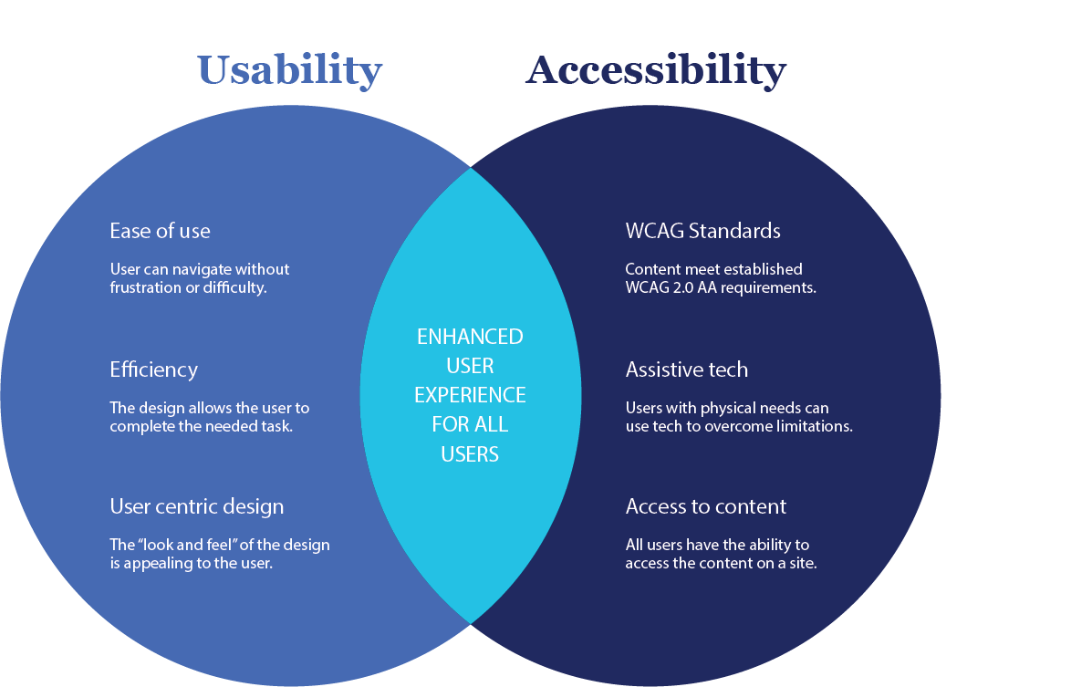
Course Design with Accessibility in Mind
Accessibility and Usability for Equitable Student Experience
NOTE: Analyze image and see following slide for context.
Image source: https://blankfactor.com/insights/blog/disabilities-and-ux-accessibility/
Notes:
Usability and accessibility are interconnected; however, a course design and navigation can be usable but the content is not accessible (i.e., low color contrast, missing all tags, missing transcripts/close captions. This has to be explicit in faculty training.
Show example with Ultra page.
Share Course page: https://blackboard.towson.edu/ultra/courses/_262150_1/outline/edit/document/_9635509_1?courseId=_262150_1&view=content

Slide 12
Course Design with Accessibility in Mind
Accessibility and Usability for Equitable Student Experience
Usability and accessibility combined aim for an enhanced user experience for all learners
Key Understanding: Course structure and navigation can be usable, but the content is not accessible (i.e., low color contrast, missing all tags, missing transcripts/close captions etc.)
Accessibility and Useability must be explicit in course design and LMS training ​
Images and text on the page must be accessible by learners using assistive technologies.* (alt tags, bulleted items, font)
*An accessible Ultra digital course content page was demonstrated in the seminar presentation using Ally.
Notes:
Usability and accessibility are interconnected; however, a course design and navigation can be usable but the content is not accessible (i.e., low color contrast, missing all tags, missing transcripts/close captions. This has to be explicit in faculty training.
Show example with Ultra page.
Share Course page: https://blackboard.towson.edu/ultra/courses/_262150_1/outline/edit/document/_9635509_1?courseId=_262150_1&view=content

Slide 13
Course Design with Accessibility in Mind
Why is digital accessibility important at Towson University?
Legal Obligations for Accessibility (ADA, Section 504)
Joint Letter from the U.S. Department of Education, Office for Civil Rights (OCR), and the U.S. Department of Justice (DOJ)
The University System of Maryland provides USM institutions Guidelines for Accessible Course Materials and Online Courses.
Notes:
Summarize
Legal - regarding the Departments’ ongoing efforts to address barriers that prevent people with disabilities from participating in online services, programs, and activities that colleges, universities, and other postsecondary institutions make available to students and the public.
Consistent with these guidelines, FACET supports faculty integration of accessibility as a forethought in course design, rather than an afterthought.
FACET, ADS, and Blackboard partner to support faculty in meeting institutional accessibility aims.

Slide 14
Course Design with Accessibility in Mind
How do we support faculty in digital accessibility at Towson University?
FACET Faculty Professional Development Self-Paced Workshop
Ultra Course Templates
Ultra Content Editor for Accessible Headings
Ally Alternative Formats*
SIX Essential Steps
Quality Matters Standard 8**
Sources:
Division of Information Technology, Six Essentials Steps, University of Maryland, College Park.
The QM Higher Ed Rubric, Seventh Edition (2023).
*Ally alternative formats: Beeline reader, immersive reader, and audio were demonstrated in the presentation in a Blackboard Ultra course.
**FACET faculty training content on QM Standard 8: Accessibility and Useability was presented in the presentation
Notes:
Ultra Content Editor with built in Accessible Headings - reduce file uploads when not necessary
SIX Essential Steps -
Ally Alternative Formats – Benefit all learners - BeeLine Reader alt format – benefits people with dyslexia, ADHD, low vision, and anybody who may have difficulty with visual tracking or focus.
https://itaccessibility.umd.edu/ally

Slide 15
Course Design with Accessibility in Mind
How do we support faculty in digital accessibility at Towson University?
FACET Podcast
Faculty Success: Higher Ed Conversations
Course Design with Accessibility in Mind, episode
Instructional Design Consultations
CourseLeaf SYLLABI software tool
Notes:
Teresa

Slide 16
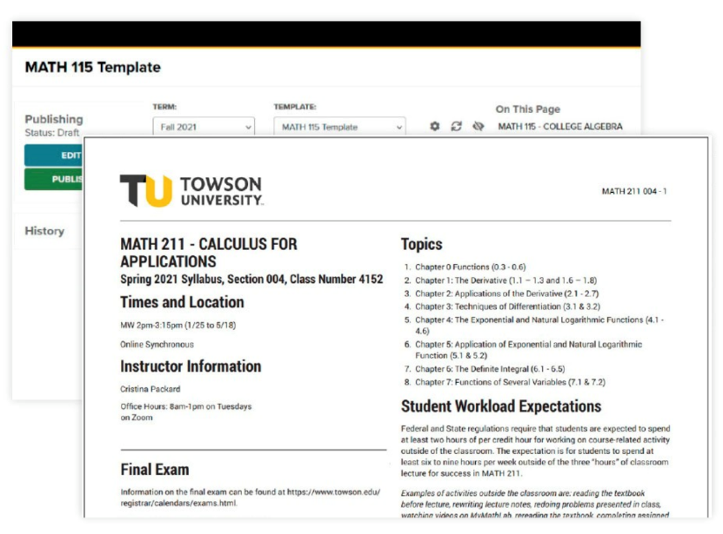
CourseLeaf SYL
Compliant Syllabi Software Tool
Multiple Formats
HTML
PDF
Baked in features:
Screen reader compatibility
Heading structure
List structure
Table support
Notes:
SYLLABI (SYL)
SYL lets faculty create, edit, and add syllabus content in seamless integration with internal system to achieve consistency and compliance across campus
Automatically keep campus policies up to date
faculty manage their own content
students can access online syllabi repositories with ease
Brian will walk through the process of vetting the SYL service accessibility features and were effectively baked in prior to attempting to ramp up staff utilization.
Larger campus efforts to support digital accessibility involves numerous stakeholders with some hand in accessibility in various ways.

Slide 17
TU Accessibility Advisory Committee
The purpose of the Accessibility Advisory Committee is to help create an inclusive, welcoming campus environment that meets the needs of students, faculty, staff and visitors with disabilities at Towson University.
Committee Members
Katherine Peters: (Chair) University ADA Coordinator, ADA Compliance and Civil Rights Investigator
Patricia Bradley: Vice President, Office of Inclusion and Institutional Equity
Joshua Hayes: Assistant Vice President, Equity & Compliance
Robyn McCray: Director, Accessibility and Disability Services
Sara Slaff: Vice President, Legal Affairs and General Counsel
Nathan Barker: Employee and Labor Relations Manager
Donna Yeagle: HR Policy Analyst & ADA Coordinator
Barbara Menges: Coordinator, Interpretive Services/Human Resources Benefits
Pamela Mooney: Director, Parking and Transportation Services
Gerald Jerome: Associate Professor, Department of Kinesiology
Karen Eskow: Associate Dean, College of Liberal Arts
Briella Chen: Assistant Professor, Department of Special Education
David Mayhew: University Architect, Department of Facilities Management
Jennifer Wicklein: Associate Director, Digital Experience Technology
Matthew Wynd: Director, Information Technology Support
Brian Williams: Digital Accessibility Analyst
Brittny Ballard: Learning Technologies Librarian, Cook Library
Erika Carlson-Hiles: Associate Director, Enrollment Services
Charles Herring: Director of Public Safety and Chief of Police
Scott Beyer: Director, Event & Conference Services
Teresa Valais: Senior Instructional Designer, FACET

Slide 18
Designing Computer Interfaces for Blind Users
Part of the Undergrad Computer Information Systems Catalog
Introduction to the Social Model of Disability
Best practices for creating web content and applications with accessibility in mind
Backing regulations, guidelines, and laws surrounding digital accessibility
Instructed by a professor with blindness
Notes:
Brian – technical nature of your role and specific efforts you've been involved in
Designing Computer Interfaces for Blind Users

Slide 19
The Instructional Barrier: Crestron Classroom Panel
Convenient touch screen interface
Utilize multiple screens with various inputs
Instant volume/no show control
...Not accessible out of the box

Slide 20
Solving the Barrier: Equivalent HTML Alternative
A collaboration with:
The requesting professor
TU Client Services + OTS Accessibility
Visual Sound Incorporated
Deque Systems
Result:
Equivalent, HTML based accessible classroom interface
Reusable solution at Towson University
VPAT completed by third party accessibility vendor (Deque Systems)
A vetted product for future Visual Sound Incorporated use

Slide 21
The End Result
Accessible Classroom Technology Panel

Slide 22
Additional Supports
The completion of this Creston project doesn’t mark the end of remediation efforts at Towson University.
Automated and manual accessibility testing
Accessibility baked into the procurement process
Accessibility baked into the project management process
Ensuring a pathway to report barriers to accessibility
Notes:
Brian talks about the four bullet points in his work on next four slides

Slide 23
Automated and Manual Accessibility Testing
Monthly automatic SortSite report generation
Organized by content owner
Differentiating between content level barriers and technical level fixes
Useful for reinforcing accessibility best practices
Provides the opportunity for manual testing

Slide 24
Accessibility Baked Into the Procurement Process
Largely influenced by USM Guidelines for Procuring Accessible Technology
VPATs used to assist in making decisions regarding the accessibility of commercial products
VPAT content verified with manual accessibility testing:
Screen reader testing (desktop and mobile)
Automated accessibility testing
Color contrast testing
Keyboard navigation
Notes:
Brian

Slide 25
Accessibility Baked Into Project Mangement
A product deemed accessible in a test environment can be made in inaccessible during configuration:
Color contrast
Not using alt tags for added images
Improperly configured tables
Key points in campus technology projects:
Early involvement!
Establishing relationships
Discussion of requirements and best practices
Built-in time for accessibility testing
Notes:
Renewing technology

Slide 26
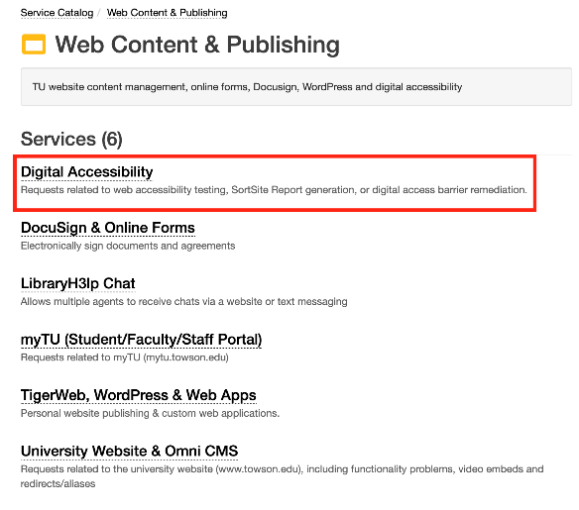
Ensuring a Pathway to Report Barriers to Access
Digital Accessibility Service added to IT Service Catalog
Available to Students, Faculty, and Staff
Discussed in faculty and staff orientation as an available resource
Report barriers to accessibility:
TU web accessibility barriers
Screen reader incompatibilities
Request testing for new web content
Notes:
Brian talks over the ticket system to prevent and remediate barriers.

Slide 27
Shared Insights for Enhancing Digital Accessibility
Implement Faculty Professional Development Training
Digital accessibility legal requirements
Accessible curricular materials and course design
Accessible instructional tools vetted by the institution
Identify and Engage with Accessibility Campus Partners
Office of Inclusion & Institutional Equity, Accessibility and Disability Services, Office of Technology Services, faculty and students with disabilities, FACET and Colleges
Contribute to the campus-wide Accessibility Advisory Committee
collaborate on digital accessibility for teaching & learning and forge partnerships to TEAM with campus units to forward institutional digital accessibility efforts
Notes:
Teresa

Slide 28
Next Steps
Increasing faculty awareness and training on accessible instructional technology tools integrated in Blackboard as well as the Ally accessibility features built-in Ultra through ongoing coordination with OTS as the campus transitions to Ultra Fall 2024
Increasing faculty utilization of the accessible Syllabi software through training and coordination with the Registrar's Office.
Enhancing digital accessibility for equity, access, and inclusion for the TU community
Notes:
Teresa will update

Slide 29
Digital Accessibility Resources
Mancilla, R., & Frey, B. A. (2023). Guide to digital accessibility: Policies, practices and professional development.
USM Guidelines for Accessible Course Materials and Online Courses
WebAIM
National Center on Accessible Educational Materials

Slide 30
Presentation Q&A

