Slide 1
The VALUE Initiative
Valid Assessment of Learning in Undergraduate Education
Launched in 2007
Campus-based
Authentic assessment of student work
Privileges role/importance of faculty as authors of assignments and arbiters of quality

Slide 2
The VALUE Initiative
“VALUE builds on a philosophy of learning assessment that privileges multiple expert judgments and shared understanding of the quality of student work through the curriculum, co-curriculum, and beyond over reliance on standardized tests administered to samples of students disconnected from an intentional course of study.”

Slide 3
The National VALUE Project
Minnesota Collaborative (MN)
Great Lakes Colleges Association (GLCA)
Multi-State Collaborative (MSC)
Gates Foundation
Spencer
Foundation
Sherman Fairchild
Foundation

Slide 4

Taking the Vision to Scale in Twelve States
MSC Participants:
CT, HI, IN, KY, MA, ME, MO, MN, OR, RI, TX and UT
Steering Committee: State pt. persons from each state + reps. from SHEEO & AACU.
Goals:
-Root assessment of learning in authentic work & the expertise of faculty
Institution Point Persons: Person from each campus in each state.
-Establish benchmarks for essential learning outcomes
-Develop transparency of shared standards of learning to assist w/ transfer

Slide 5
Foundational Work for the MSC Pilot:
National Capacity for Direct Assessment using the VALUE Rubrics

Slide 6
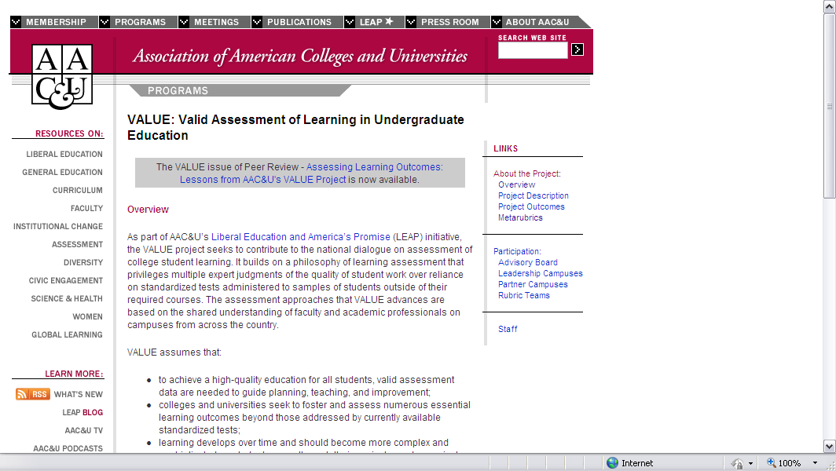
VALUE Project
http://www.aacu.org/programs/VALUE

Slide 7
Capturing What Matters:
VALUE Rubrics Initiative
Rubric Development
  16 rubrics
  Created primarily by teams of faculty
  Inter-disciplinary, inter-institutional
  Three rounds of testing and revision on campuses with samples of student work
  Intended to be modified at campus-level
Utility
  Assessment of students’ demonstrated performance and capacity for improvement
  Faculty-owned and institutionally shared
  Used for students’ self-assessment of learning
  Increase transparency of what matters to institutions for student learning

Slide 8
VALUE Rubrics
(www.aacu.org/value)
Knowledge of Human Cultures & the Physical & Natural Worlds
  Content Areas →No Rubrics
Intellectual and Practical Skills
  Inquiry & Analysis
  Critical Thinking
  Creative Thinking
  Written Communication
  Oral Communication
  Reading
  Quantitative Literacy
  Information Literacy
  Teamwork
  Problem-solving
Personal & Social Responsibility
  Civic Knowledge & Engagement
  Intercultural Knowledge & Competence
  Ethical Reasoning
  Foundations & Skills for Lifelong Learning
  Global Learning
Integrative & Applied Learning
  Integrative & Applied Learning

Slide 9
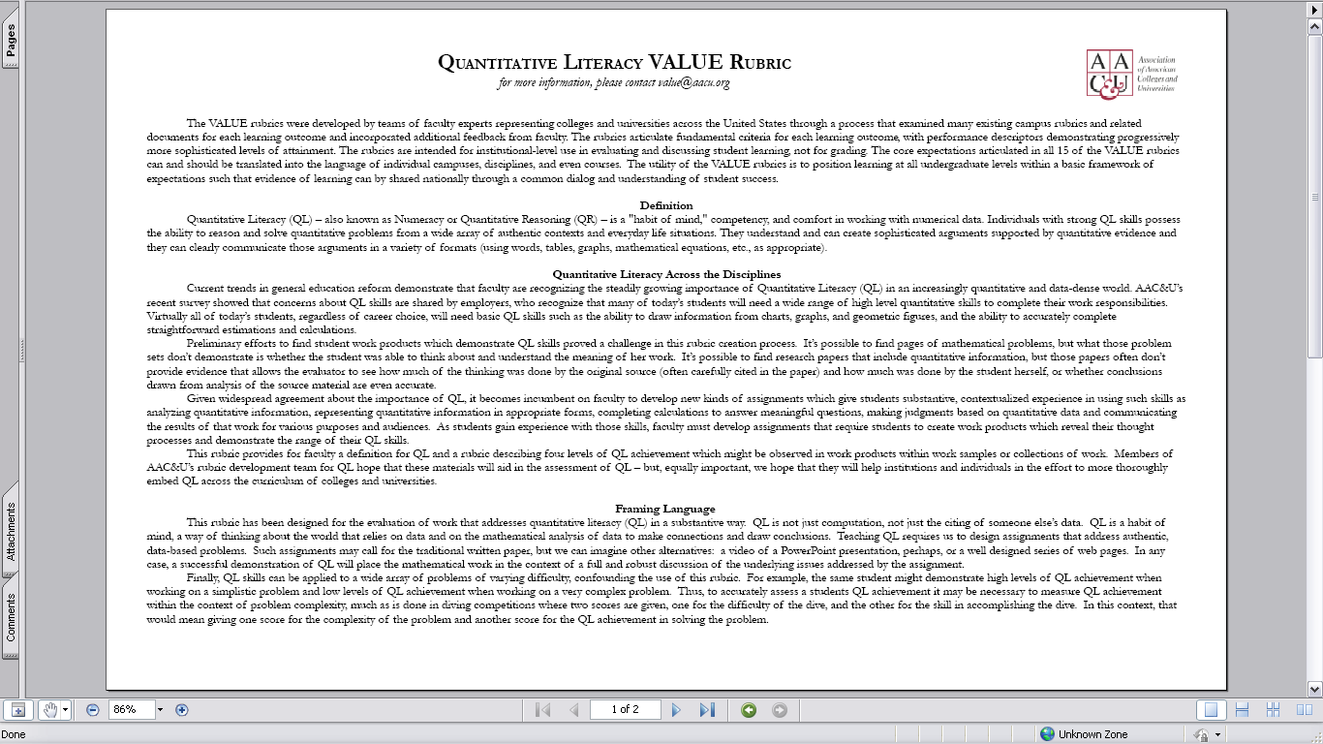

Slide 10
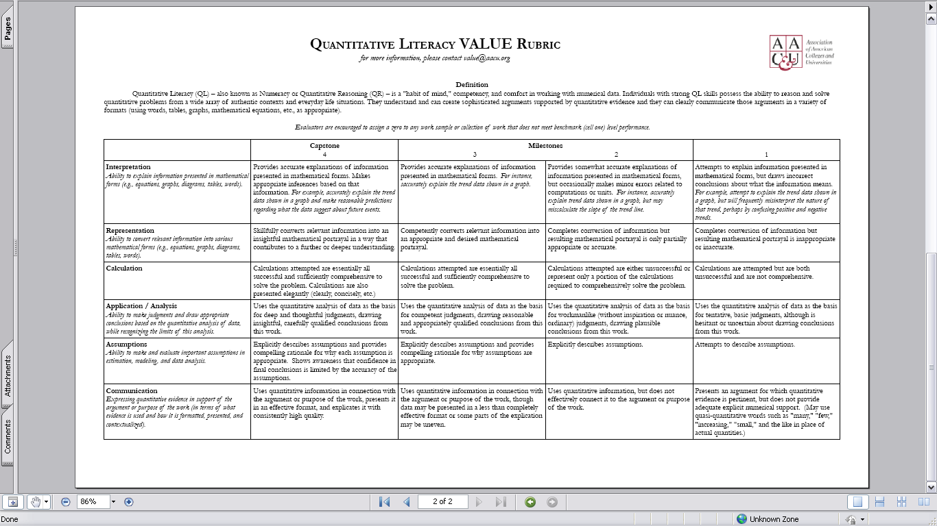

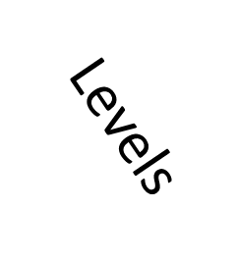


Criteria
Performance Descriptors

Slide 11
The National VALUE Project
Purpose
  Proof of concept
  Reliability
  Validity
  Local value
MN
GLCA
MSC

Slide 12


Sample Results – MSC Pilot Year
Results from a proof-of-concept pilot study
59 institutions in nine states (28 4-yr; 31 2-yr)
Using common rubrics to assess more than 7,000 student work products
Students 75% or more coursework completed
Results are not generalizable for all students in each participating state or nationwide.

Slide 13
Example:
Quantitative Literacy

Slide 14
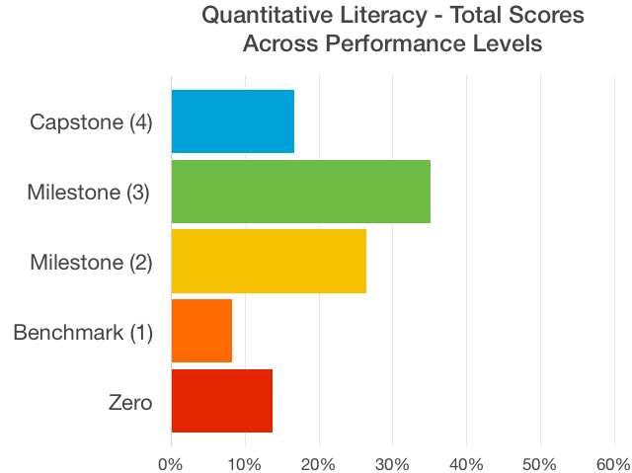

Slide 15
But what does that tell us?
Total score information interesting, but is it actionable? (Ask the same question of data presented as a mean score!)
Power of VALUE approach = Breaks Essential Learning Outcomes (ELOs) down into its constituent parts
Articulates measurable criteria that in total represent the ELO, but are specific enough to provide actionable data from a pedagogical perspective

Slide 16
But what does that tell us?
In other words, VALUE captures more nuance, creates potential for more meaningful action when “closing the loop”

Slide 17
Back to Quantitative Literacy
Calculation vs. Assumptions (i.e., the ability to make and evaluate important assumptions in estimation, modeling, and data analysis)

Slide 18
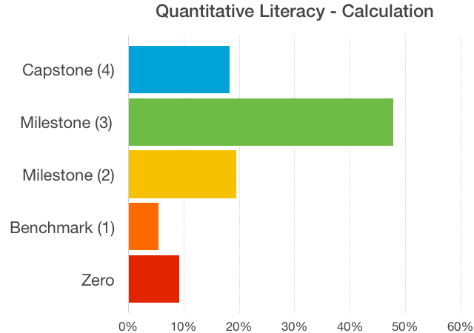

Slide 19
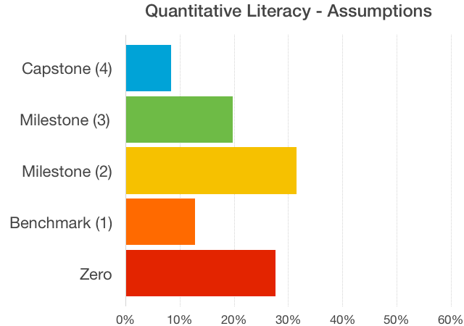

Slide 20
What questions does this prompt?

Slide 21
Other interesting observations from the MSC Pilot data
Broadly speaking, stronger scores were observed for those criterion that aligned with the “knowledge/comprehension” level of Bloom’s Taxonomy
  Ex. Higher scores were assigned to criterion such as calculation (Quantitative Literacy), syntax/mechanics (written communication), and explanation of issues (Critical Thinking)

Slide 22
Other interesting observations from the MSC Pilot data, con’t.
Broadly speaking, stronger scores were observed for those criteria that aligned with the “knowledge/comprehension” level of Bloom’s Taxonomy
  Ex. Scores suggest that students struggle with using evidence effectively to support a thesis/argument (Written Communication, Critical Thinking)

