Slide 2
Open Education Pedagogy in Public Health to Address the Global Challenges of Our Time
Presentors: Dr. Negin Fouladi; Maryam Hashmi, MPH Candidate; Duncan Coltharp, BS in Public Health Science Candidate
2023 Maryland OER Summit

Slide 3
Challenges of Our Time and Need for Public Health Open Education Resources (PH-OER)
Pandemic presented challenges & changed teaching and research environment.
Students struggled with navigating through traditional didactic and linear teaching approaches in online settings.
Pandemic highlighted struggles faced by nations to improve population health and the need for timely evidence-based research to inform practice and policy.
Need to develop innovative and inclusive OER to promote student engagement, address community needs, and solve healthcare issues in real-world settings.

Slide 4
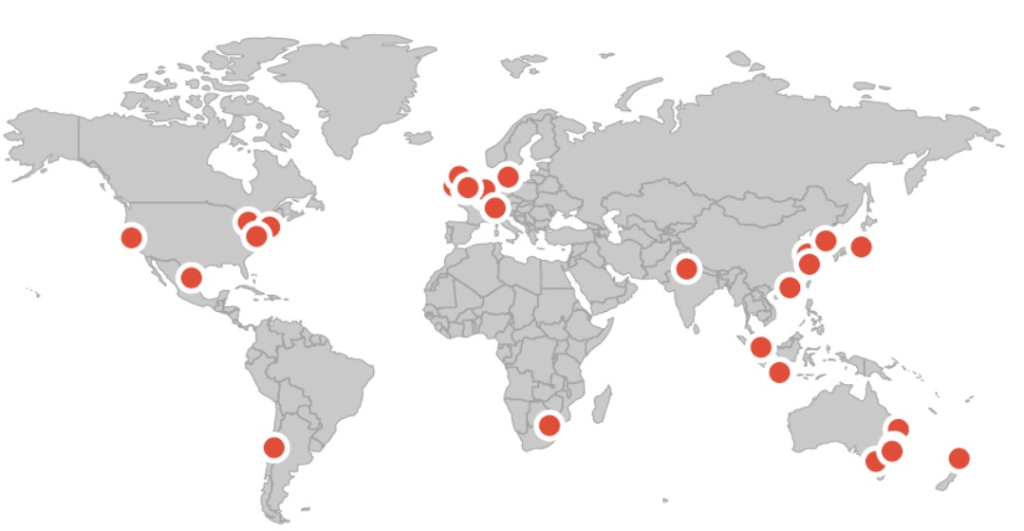
International Partnerships to Facilitate use of PH-OER
Project addresses lack of DEI in research and practice via an innovative student designed and driven Comparative Public Health OER to facilitate global Research and Practice for graduate and undergraduate programs at UMD-SPH.
Collaboration with Universitas 21 Global academic partner institutions will provide a learning environment to advance lifelong learning and build deep cross-national connections.
Universitas21 Virtual
Health Research Exchange (U21HREx)
Lead- UMD College Park
University of Birmingham, UK
University College Dublin, Ireland
Twitter/X @U21_HREx

Slide 5
Project Team
Students, Primary Stakeholders
Maryam Hashmi, MPH in Practice and Policy Candidate, Department of Health Policy and Management, School of Public Health
Duncan Coltharp, BS in Public Health Science Candidate, School of Public Health, Universities at Shady Grove
Public Health/Health Systems, International Collaboration/Engagement Expertise
Dr. Negin Fouladi, Project Lead, Associate Clinical Professor and Director of Online Graduate Studies, Department of Health Policy and Management , School of Public Health
Professor Mark Exworthy, University of Birmingham, UK, Health Services Management Center
Global Learning Expertise
Dr. Raluca Nahorniac, Director, Office of International Affairs, Global Learning Initiatives
Dr. Taylor Woodman, Assistant Clinical Professor and Associate Director, Office of International Affairs, Global Learning Initiative
Library Sciences, Research, and OER Expertise
Nedelina Tchangalova, Public Health Librarian, University of Maryland STEM Library
Eileen Harrington, Assistant Director & Health and Life Sciences Librarian, University of Maryland Priddy Library
Culturally Responsive and Equitable Evaluation/Systems Thinking Expertise
Dr. Arthur Hernandez, American Evaluation Association (AEA)
Dr. Ralph Renger, CEO, Just Evaluation Services, LLC

Slide 6
Implementation
PH-OER to include content modules and experiential-learning project-based team case studies identified and implemented with University of Birmingham (UoB), UK.
Working with Rebus Textbook Success Program to become familiar with OER creation and dissemination on Pressbooks publishing platform.
PH-OER implemented in graduate and undergraduate courses Fall/Spring.
Content and case studies focused on health policy, services, management developed via a Systems Thinking and Culturally Responsive and Equitable (CREE) lens.

Slide 7
Outcomes and Assessment
Student Surveys to assess knowledge and professional development needs of graduate and undergraduate students, student diversity, interest in international collaboration, and organization/usability and usefulness/applicability of the PH-OER content for research, practice, and professional development.
Evaluate level of faculty and student engagement (UMD /UoB) with PH-OER throughout implementation to identify challenges, evolving patterns, and best practices to scale, maintain, and sustain the resource and engagement over time.
Student reflective exercise to assess if the PH-OER provided relevant and timely real- world scenarios and applications. Findings from the exit survey and reflective exercise will be used to improve MPH-PHPP, MHA, and PHS course content and structure to meet the needs of students.

Slide 8
Student Engagement and Impact
Duncan Coltharp- Bachelor of Public Health Candidate
Undergraduate Involvement
Advancing teaching tech
Contributing to future students’ access
Value of student input
New resources should tailored for student needs
Collaboration with Graduate Students and Faculty
Disability access
Student White Paper for Disability Access
20 page paper based on survey with nearly 100 (98) USM student respondents

Slide 9
Student Engagement and Impact
Duncan Coltharp- Bachelor of Public Health Candidate
Outcomes
Online Education Resource Familiarity
Curriculum development experience
Lessons learned so far
Prioritize a framework and workflow
Identify your tools first
Suggestions
Develop modules for undergraduate students
Recruit student representatives from

Slide 10
Student Engagement and Impact
Maryam Hashmi - Master of Public Health Candidate
Impact from my involvement
Voice of Graduate students
Free access to course material for faculty & students
Ability for students to come together globally
Lessons learned
Learning the material is easy but putting it into action is harder
Getting ethics approval
Coordination within internal organization
Designating roles
Challenges
Timelines
Projects for Undergraduate & Graduate students
Wins
Global public health experience
Writing & academia experience

Slide 11
Questions?
Feel free to contact Dr. Negin Fouladi fouladi@umd.edu

