Slide 1
Graduate Learning Outcomes Assessment:
The State of Play Nationally
Maureen Terese McCarthy
Associate Director,
Advancement and Best Practices
Council of Graduate Schools
Notes:
As you know, most of the conversation about SLOs has been happening at the undergraduate level.
Good reasons for ignoring grad ed: things are going well.
US Grad ed is still the international standard
Students with master’s and doctoral degrees (let alone professional degrees)
lower rates of unemployment and
higher salaries compared to their peers with bachelor’s and less.
But this is changing.
Three factors are driving an increased interest in SLOs at the graduate level:
1) Increasing demand for workers with advanced and specialized knowledge and skills;
Need to diversify the pool of individuals with advanced education;
Decreasing public investments in graduate education (you tell me)

Slide 2
Drivers of Change
Increasing demand
for specialized knowledge and skills
Need to diversify
the pool of individuals with advanced education
Decreasing public investments
in higher education

Slide 3
Increasing demand
Expected Job Growth (2014 – 2024) by degree at entry level
Source: U.S. Bureau of Labor Statistics.

Slide 4
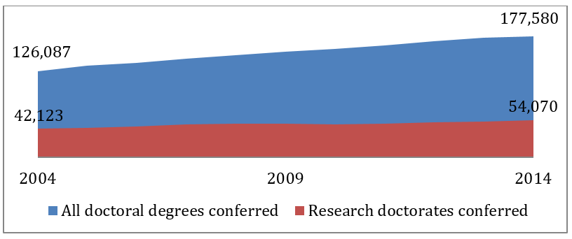
Professional doctorates account for the majority of growth in doctoral attainment.
Data Sources: National Science Foundation, Survey of Earned Doctorates, 2015, Table 13, and U.S. Department of Education, Digest of Education Statistics, 2015, Table 324.10
Notes:
Recent growth of earned doctorates is largely attributable to professional doctorates.

Slide 5
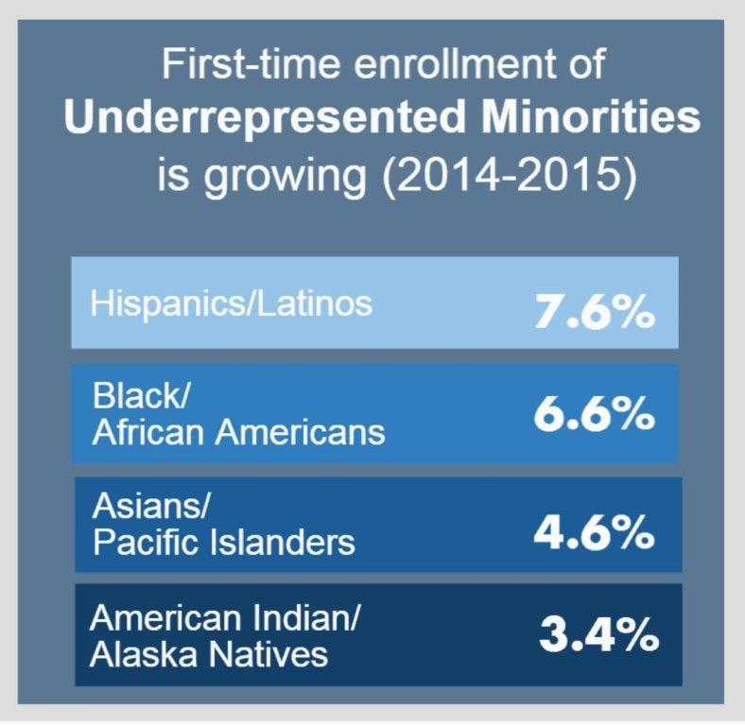
Need to diversify
Source: 2016 CGS Graduate Enrollment and Degrees
Notes:
In the U.S., But nowhere near parity with population of young adults in the U.S. Adult population closer to: 15% Hispanic, 13% Black/African American, [4.43% Asian, 1% American Indian/Alaska Native/Pacific Islander].
Meet growing workforce needs;
Respond to evidence that diversity improves the quality of educational experiences for all;
Comfort in diverse environments already a required workplace skill

Slide 6
Decreasing public investments
Notes:
You tell me.
New pressures on universities to demonstrate the value of graduate degrees
Making SLOs more transparent has the potential to benefit graduate education by:
providing the broader public with a better understanding of the value of different credentials;
PUBLIC value vs. private value (talked about above)
Lower Ed (Tressie McMillan Cottom)
help institutions respond to calls for accountability;
demonstrate ROI
prompt faculty to craft their programs intentionally; and
increase transparency for students.
(But you already know that. That’s why you’re here.)
CGS has conducted some recent research about SLOs at the doctoral level. I’m going to talk BRIEFLY about what we found, because it’s a good gauge for seeing how far the national conversation about SLO’s is penetrating into the graduate space.

Slide 7
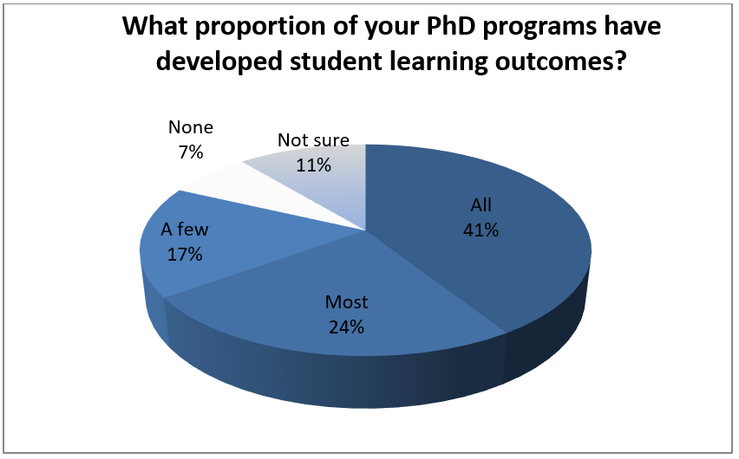
Most doctoral programs have developed SLOs.
Source: CGS Pressing Issues Survey, 2016. Council of Graduate Schools.
Notes:
A 2016 CGS member survey found that at 65% of responding U.S. doctoral institutions, all or most PhD programs have developed learning outcomes for their own use.
In the spring of 2016, CGS conducted a brief survey questionnaire of our 241 member doctoral-granting universities. The survey’s 144 responses from PhD-granting institutions represent a response rate of over 60% among our doctoral university members. Collectively, CGS institutions annually award more than 91% of all U.S. doctorates (Allum & Okahana, 2015) and may be considered a representative sample.

Slide 8
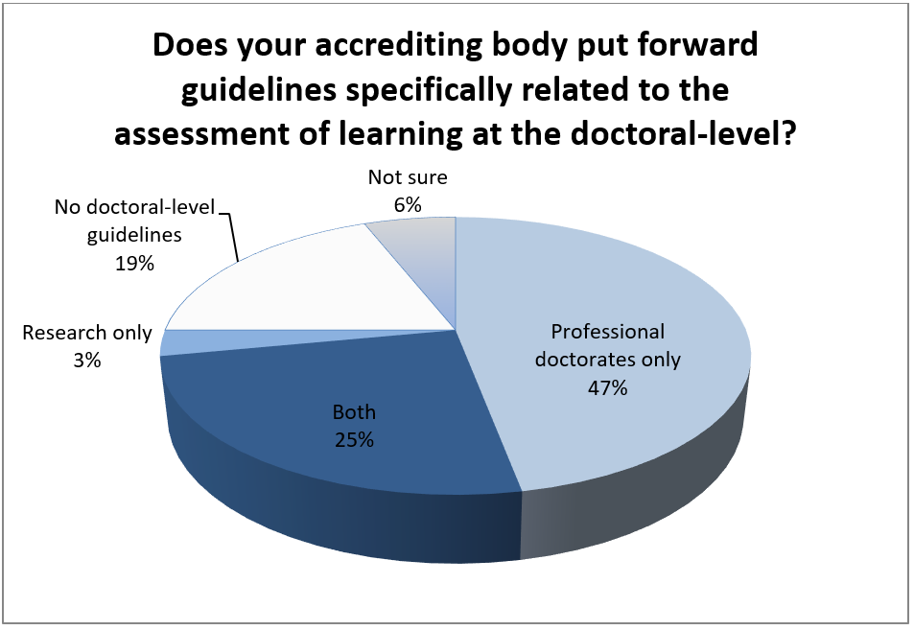
Most accreditors have guidelines for doctoral-level SLOs.
Source: CGS Survey of US Accreditors on Doctoral Learning Outcomes and Assessment, 2016. Council of Graduate Schools.
Notes:
A 2016 poll by CGS found nearly three out of four accreditors (72%) agreed they are paying closer attention to outcomes assessment in doctoral education than five years ago (Fig. 2).
Differences between the Ph.D. and practitioner doctorates (saw above prof. docs account for most of growth)
All this is to say that this meeting is part of a larger trend, and one that shows no sign of slowing. If anything, the US is behind the times, compared to our peers internationally.
In March and April of 2016, CGS fielded a Survey on Doctoral Learning Outcomes and Assessment with the chief officers of accrediting bodies whose scope of accreditation includes doctoral education. CGS received 32 valid responses, which represents an 80% response rate.

Slide 9
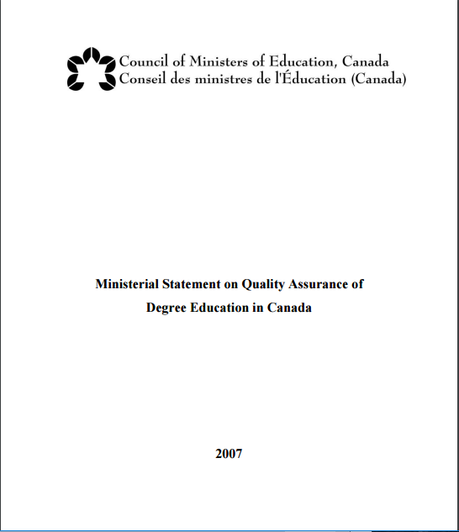
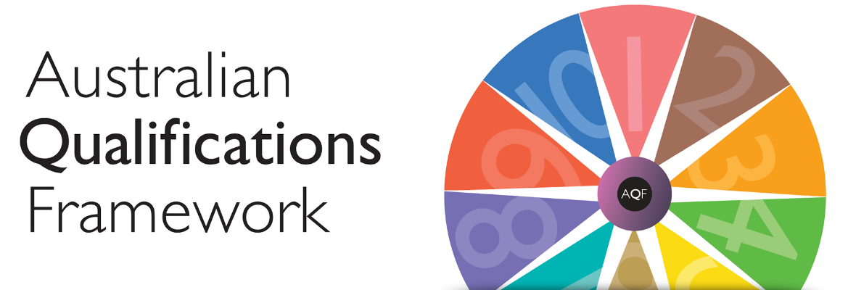
International Context
Notes:
Australia
Australian Qualifications Framework (AQF)
Canada
Ministerial Statement on Quality Assurance of Degree Education in Canada
Europe
Qualifications Framework for the European Higher Education Area (QF-EHEA) – EHEA was created as a result of the Bologna Process (50 participating countries)
Europe
European Qualifications Framework (EQF) – adopted by EU; only applies to EU countries (28 member states)
Both the QF-EHEA and the EQF allow you to compare qualifications between different national systems. The framework that was adopted by the Bologna Process (QF-EHEA) covers three cycles of higher education qualifications – 1st cycle which usually awards the Bachelor’s Degree, 2nd cycle awarding the Master’s Degree and the 3rd cycle which awards the Doctoral Degree.
The EQF, on the other hand, is designed as a lifelong learning framework and as a result, it covers all qualifications including but not exclusively academic ones like the Bologna Process.
While the wording of the EQF is not identical to that of the EHEA Framework, there are no major differences between the two, and that it is perfectly possible to develop national qualifications framework that are compatible with the EQF as well as with the EHEA Framework.
The European Qualifications Framework (EQF) is a European-wide qualifications framework which joins the qualifications of different EU members together. In a way, it is a translation of different national qualifications which makes qualifications in different EU countries easier to understand. The EQF aims to facilitate mobility of students and workers within the EU in order to encourage development mobile and flexible workforce throughout Europe and to help develop lifelong learning.

Slide 10
Lessons from Bologna
Degree frameworks must address a clear need.
Faculty and students must participate in the process, starting with preliminary discussions.
Outcomes and assessment must be linked.
Governance structures impact the pace of change.
Notes:
Because internationally this has been going on for quite some time, there are lessons to be learned from their processes. (EHEA-QF was adopted by Ministers of the Bologna Process in May 2005)
Clear need: Internal and/or external imperatives for change must be present.
Faculty and students: communicating impact of assessment (how are you using the data?) Making the process of implementing SLOs a model in transparency. Creating opportunities for faculty ownership and leadership (assessment as a faculty governance issue; giving faculty opportunities to share strategies). Are students teaching?
Governance structures: In highly decentralized systems, some form of overarching guidance can assist with the process.

Slide 11
Lessons from Bologna (cont’d)
Outcomes discussions may suggest curricular adjustments.
Universities should assist faculty in developing new pedagogical and curricular approaches resulting from a shift to outcomes.
Universities should articulate the benefits of these new approaches.
Notes:
Curricular adjustments: including the addition of courses specifically directed to professional success. At graduate level, this can be particularly fraught (WHAT WILL BE REPLACED?)
Strategies for integrating SLO’s and articulating the benefits: lessons from CGS.

Slide 12
Disciplinary Sensitivity
Gathering data about learning to inform practice.
versus
Helping students craft a narrative about their educational experience.
Notes:
Different disciplinary cultures may respond to different language about outcomes.
Linking assessment to research and scholarship (how faculty may already be practicing assessment in ways that can be expanded and refined). This is something I know Chuck has done a lot of work on, so I’ll let him talk more about how to frame these conversations.

Slide 13
Thinking holistically
Processes for recruitment, admissions, supporting student success, and evaluating student outcomes should all be mutually reinforcing
Notes:
Easier said than done.

Slide 14
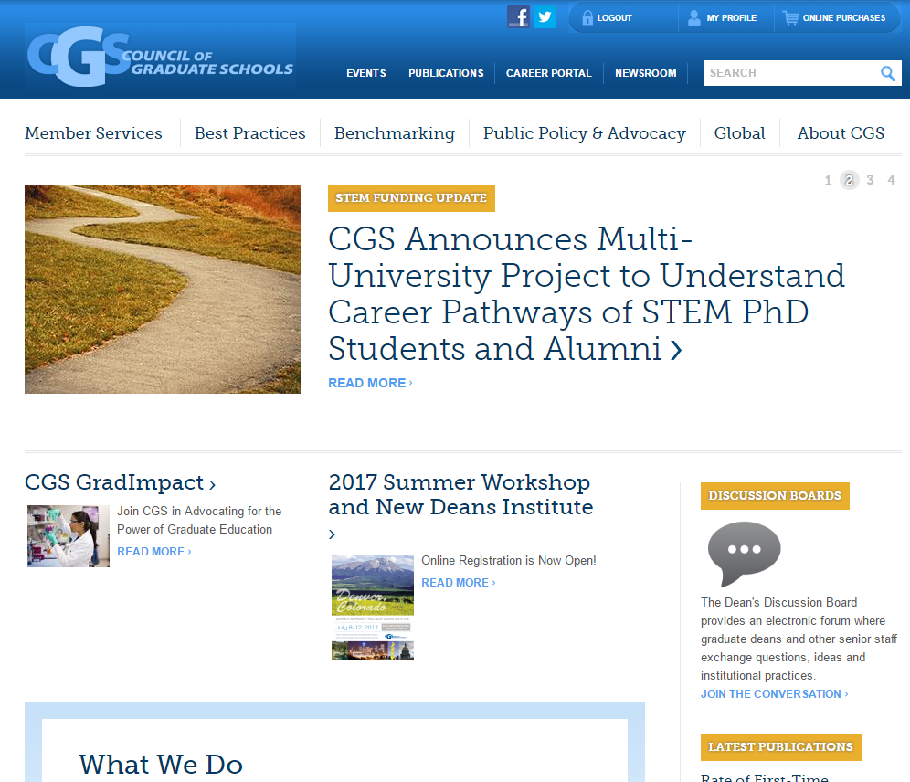
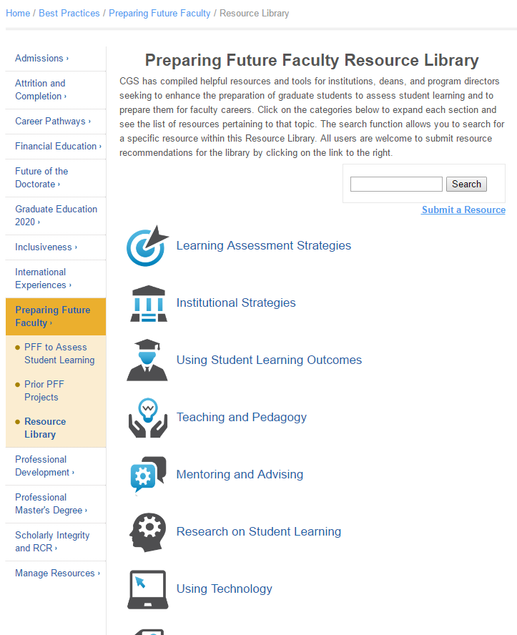
Additional Resources
CGSnet.org

Slide 15
Graduate Learning Outcomes Assessment:
The State of Play Nationally
Maureen Terese McCarthy
mmccarthy@cgs.nche.edu

