Slide 1


Making an Accessible Classroom
A joint presentation by the NFB Center for Excellence in Nonvisual Access and the MDOD IT Access Initiative

Slide 2
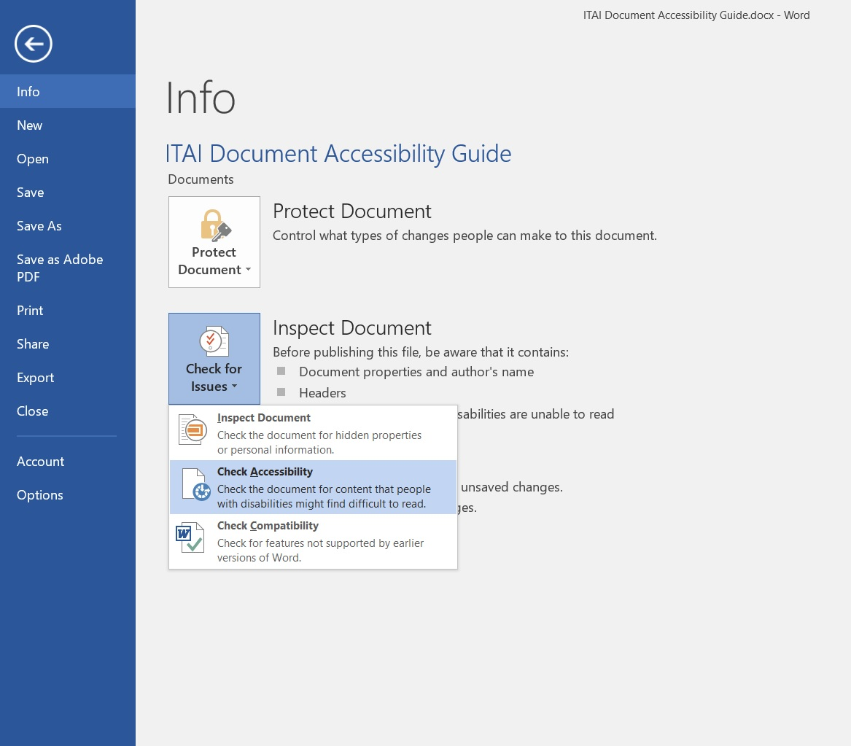
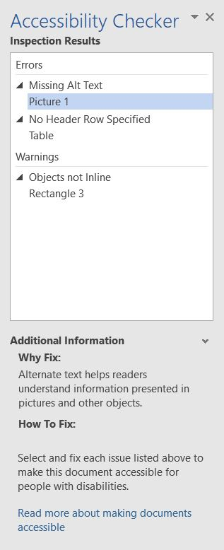
Document Accessibility
All document types should have:
  Alt text for images
  Headings for navigation
  Established intended reading order
  Run the accessibility checker for the associated program

Slide 3
Tips For Documents
Don’t lock the file
Use templates and style presets
Provide tables instead of charts/graphs
  Use real text in charts so that the data points can be tagged
PowerPoint’s reading order is from bottom to top in the Arrange Selection Pane
  Notes or comments are good for adding additional explanation
When saving as a PDF, check the “Tagged PDF” option

Slide 4
Office Suite Demo
Word
PowerPoint
Excel

Slide 5
PDF Accessibility
Use the accessibility checker (requires Acrobat Pro)
Check the reading order manually
Saving from Word is the best starting point
Consider alternative formats
  Word/HTML/E-Pub
  PDF is one of the hardest to remediate

Slide 6
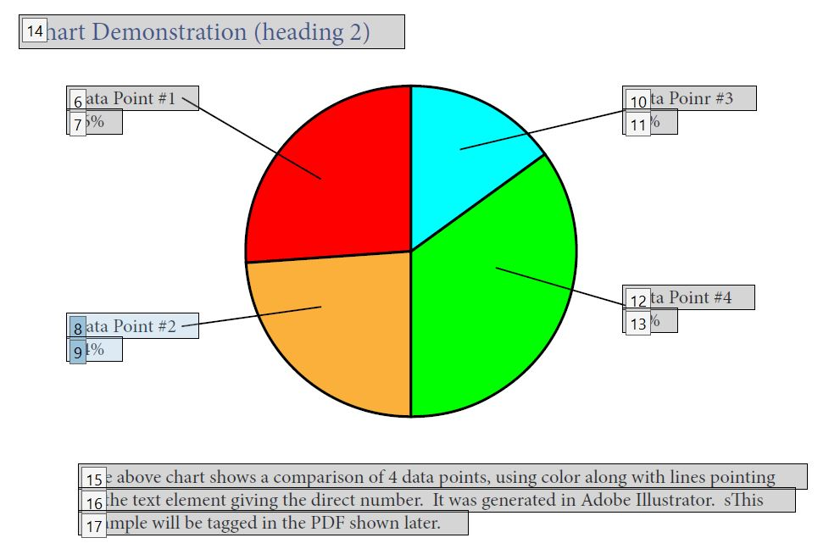
LMS Accessibility
Syllabus
Coursework
Quizzes

Slide 7
Syllabus
Use a good heading structure (heading 2 for main areas, heading 3 for subcategories, etc)
Put all content in “real” text
Any links should be text that indicates the destination
Have a separate list of assignments with due dates
Provide a Word doc in addition to the LMS copy

Slide 8
Coursework
Find the tools and guidance for your particular LMS
Have an accessibility checklist handy while creating coursework
Interactive activities will need further considerations
  Discuss other methods of conveying information & driving engagement if needed

Slide 9
Quiz Considerations
Form fields must be properly labeled (not just visually)
For multiple choice type questions, group the question with its answers
If using an image or chart, consider using an audio explanation or alternative for those with visual disabilities
Give adequate time or allow requests for additional time that are communicated to students

Slide 10
Video and Audio
Must have captioning or at least a transcript
Must have clear, descriptive language explaining actions on screen
Should mention relevant sounds in captions, transcript, and audio description
Be mindful of the limitations of the accessibility of the player used

Slide 11


Class Video Comparison
Bad Description
Good Description

Slide 12
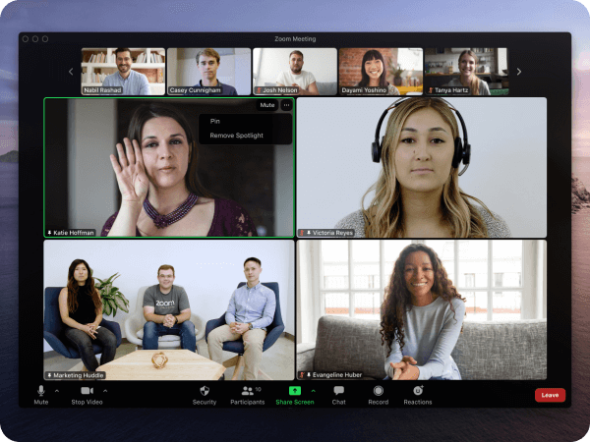
Scribe for Meetings
Available from scribeformeetings.com
Translates on screen presentations to an accessible format such as HTML
Currently only available for Zoom and MS Teams
Picture from Zoom’s Accessibility Page

Slide 13
Captioning
Recorded Material
Live Meetings
Name the speakers
YouTube: edit auto-generated captions (demo)
Add captions to other platforms using CADET – free program
AI subtitles will be around 80% accurate
Check account settings for enabling feature
Allow saving a copy of captions

Slide 14
Routing to Accessible Material
Note: These should only be done if there’s no way to have accessible material available for everyone.
Add “Accessible” to file name and title
Put it first (or link to an alternative copy)
Explain limitations or warn users of inaccessible materials
  Ensure alternative is mentioned with warning
  Look for “skip to table” or similar bypass links
For activities or interaction, give adequate time for response

Slide 15
Resources and Q&A
(Handout)

