Slide 1

Leveraging the UN SDGs to Grow an International Open Pedagogy Faculty Fellowship
Notes:
Mike

Slide 2



Open in Action at Montgomery College
Cost Savings
Student Learning
Social Justice
More than $13 million in textbook savings in Z-courses (i.e., no textbook costs)
Student success rates in Z-courses at or above non-Z courses
Fellowship of interdisciplinary, cross-institutional OER faculty partnerships to incorporate student community engagement
https://www.montgomerycollege.edu/offices/elite/unesco/

Slide 3
Open Pedagogy
“Open Pedagogy” is a site of praxis, a place where theories about learning, teaching, technology, and social justice enter into a conversation with each other and inform the development of educational practices and structures
DeRosa and Jhangiani
Notes:
Mike

Slide 4
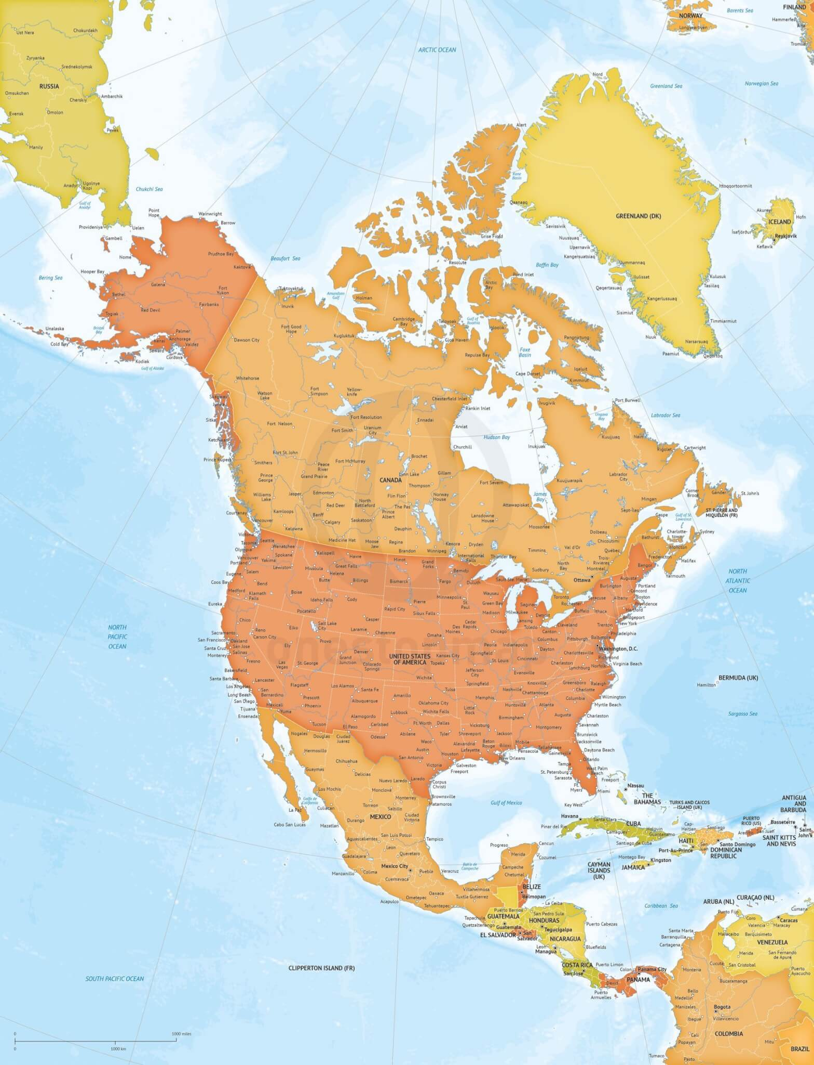
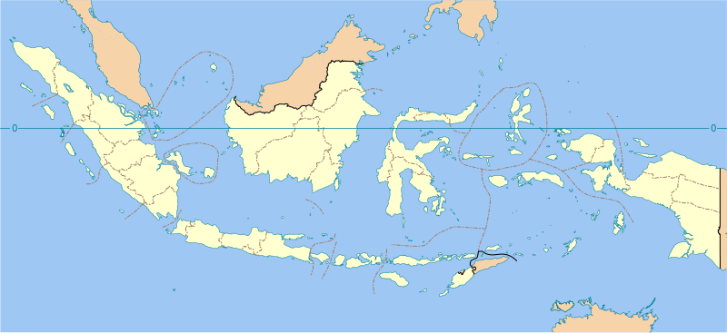
Fellowship Background
This Photo by Unknown Author is licensed under CC BY-SA
2017
Open Ed Conference - Anaheim
2018
First Fellowship Offered to Montgomery College Faculty
2019-2023
12 Additional Partners Join – US, Canada, Caribbean, Central America
2023
Formation of Asia Chapter
Notes:
Mike

Slide 5
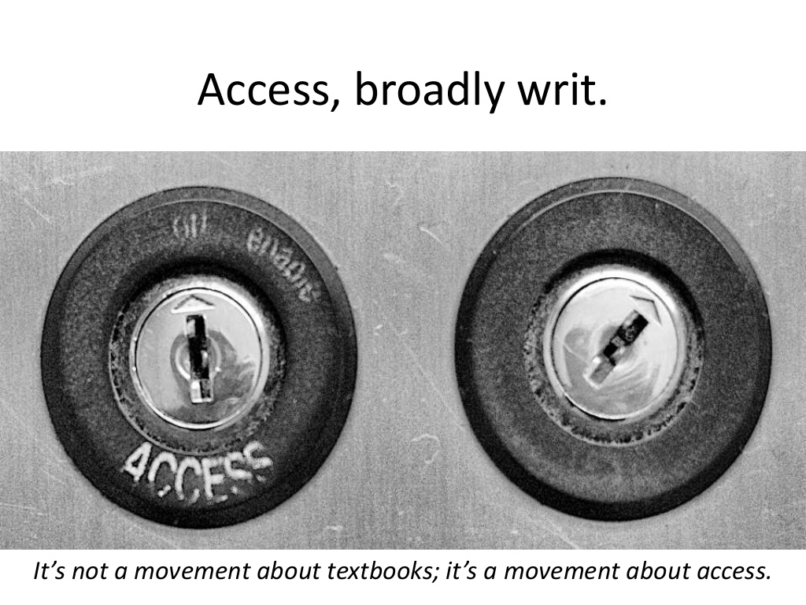
Fellowship Objectives
Increase equitable access to education
Support social justice through international partnership
Empower students in engaging and collaborative environments
Notes:
Mike

Slide 6
Fellowship Professional Learning Process
March: Call for Applications
Summer Institute
Assignment Deployment
Student Engagement
Faculty Reflection
March: Showcase
Faculty and students present together on their assignments and projects
4 required summer meetings
Students become agents of change in their own communities
Inter-disciplinary, cross-institutional faculty teams
Renewable assignments used in Fall semester classes
Faculty examine what worked and what did not and make changes for future iterations

Slide 7
Faculty Timeline
Application Process Begins
April
June - August
Selections and Announcements
Summer Fellowship
Beginning Fall
Implementation of Fellowship Work in Course(s) and Optional Student-Faculty Showcase
March

Slide 8












Leading an International Fellowship
Single Source of Information
Monthly Leadership Meetings
Structured Onboarding of New Members
Sub-committees to Tackle Specific Projects
Notes:
Mike

Slide 9
Summer 2018 | Summer 2019 | Summer 2020 | Summer 2021 | Summer 2022 | Summer 2023
15 fellows | 13 fellows | 41 fellows | 43 fellows | 20 fellows | 34 fellows
7 teams | 6 teams | 16 teams | 20 teams | 10 teams | 12 teams
Montgomery College | 2 partners: MC + KPU | 4 partners | 7 partners | 10 partners | 11 partners
F2F + online | F2F + online + hybrid | Online | F2F + online + hybrid | F2F + online + hybrid | F2F + online
12 disciplines | 11 disciplines | 23 disciplines | 26 disciplines | 22 disciplines | 25 disciplines
8 SDGs | 8 SDGs | 10 SDGs | 9 SDGs | 7 SDGs | 11 SDGs
16 different courses | 19 different courses | 29 different courses | 29 different courses | 15 different courses | 38 different courses
25 sections | 28 sections | 70 sections | 50 sections | 32 sections | 143 sections
571 students enrolled | 709 students enrolled | 1638 students enrolled | 1003 students enrolled | 492 students enrolled | 5146 students enrolled
18 students in MC Showcase | 9 students in MC-KPU Showcase | 13 students in Showcase at Arizona Regional OER Conference | 8 students in Showcase at Arizona Regional OER Conference | 4 students in Showcase at Arizona Regional OER Conference

Slide 10
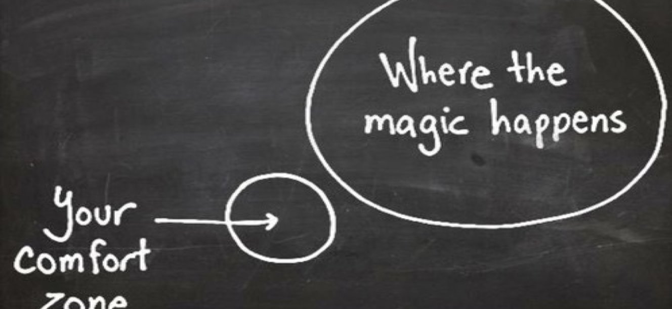
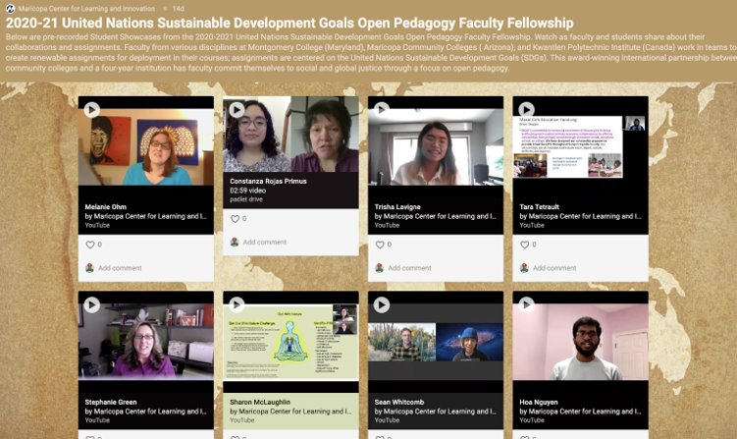
Engaging Students and Faculty
Faculty Professional Development
Scheduled Team Time
Open Labs
Mentors
Showcases
Notes:
Debbie

Slide 11

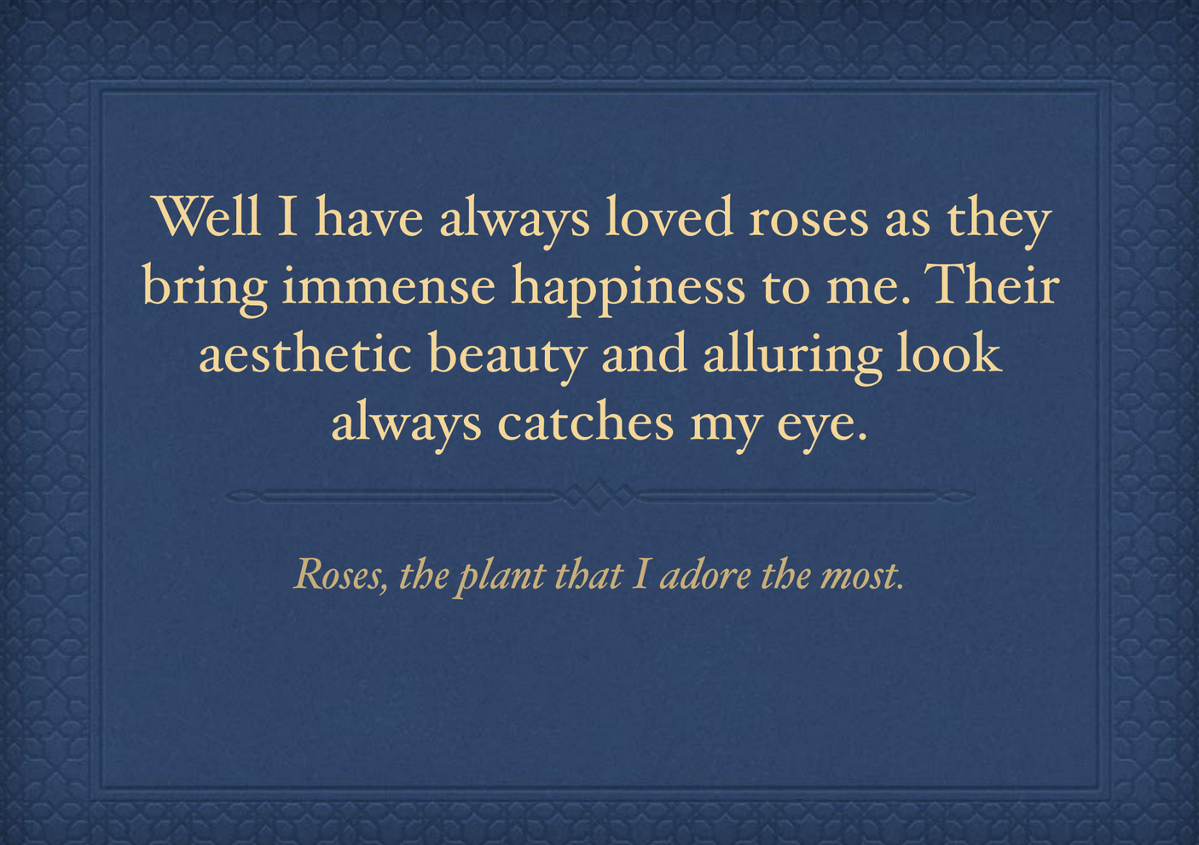

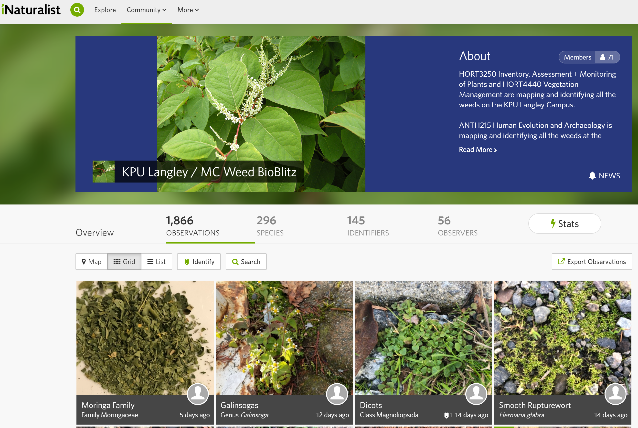
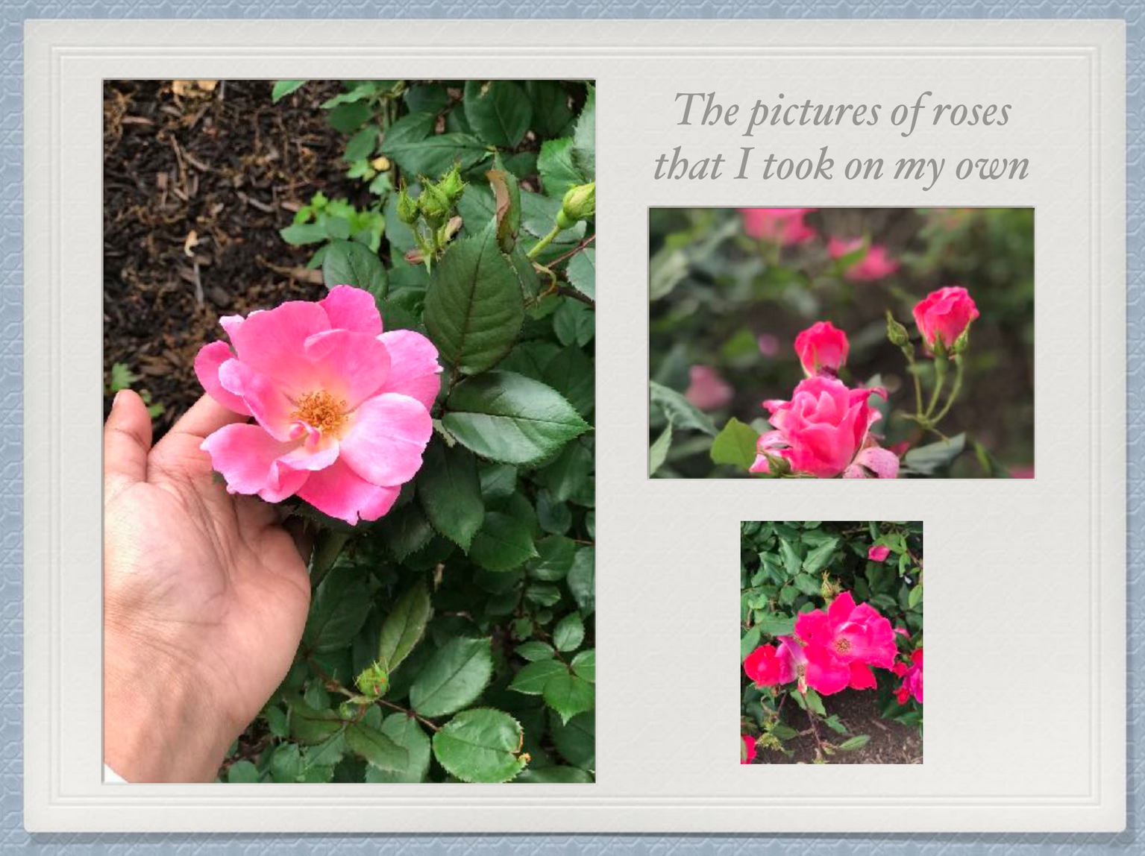
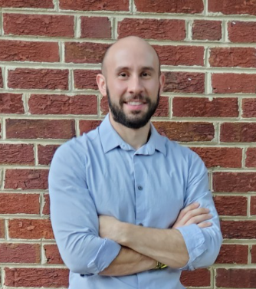
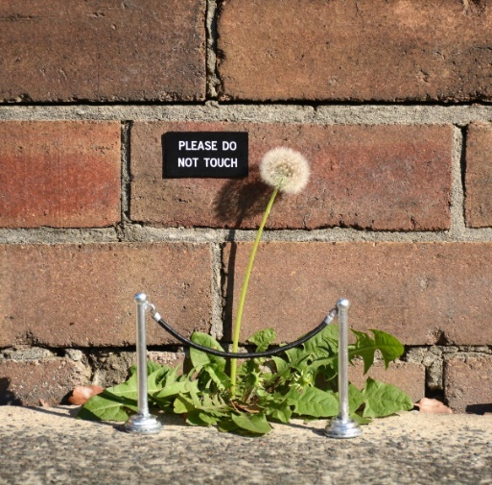
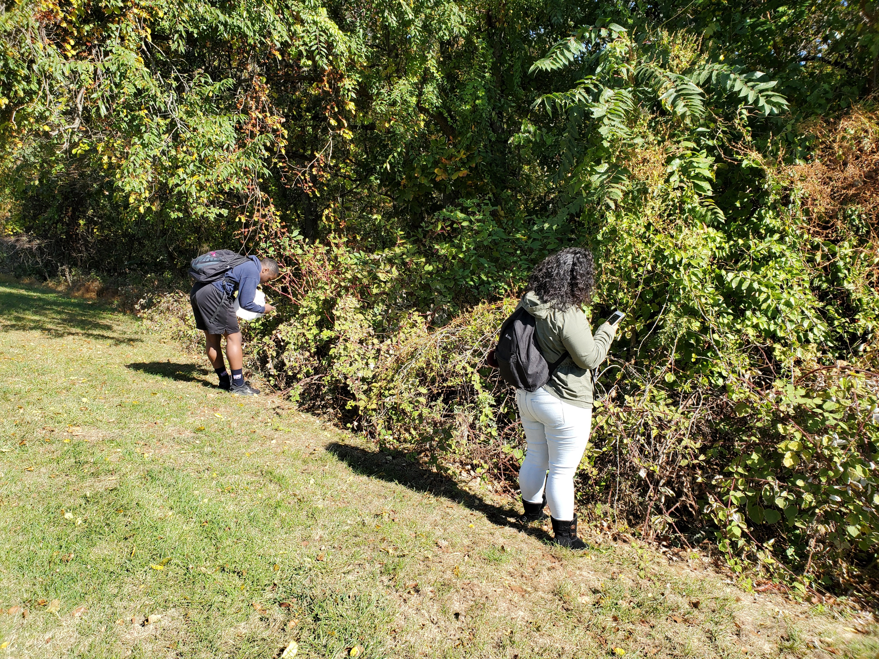


Rooting Out Hunger: Plants, Weeds, Anthropology and Student-Centered Learning
Professor Zev Cossin
Parveen Hussain

Slide 12
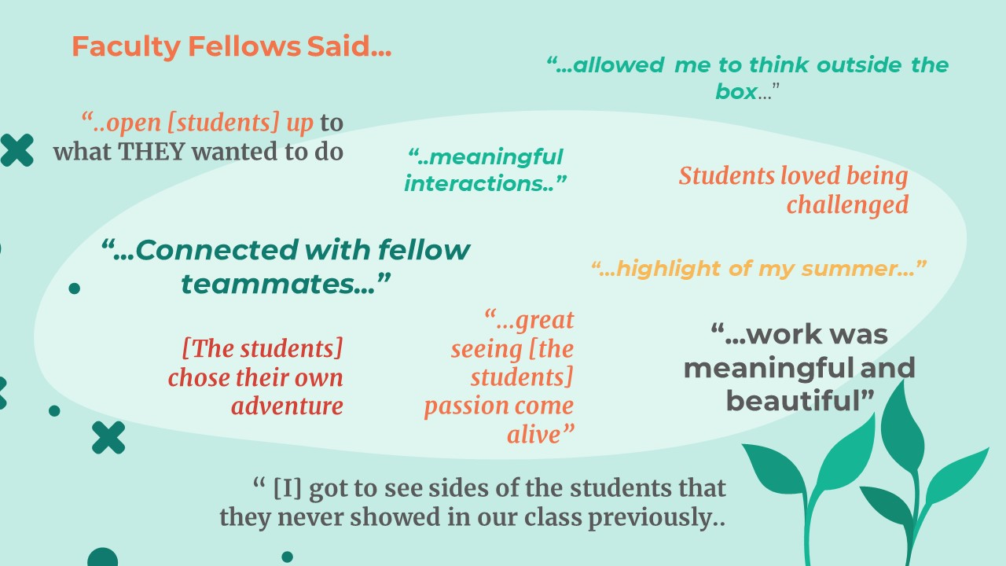
Engaging Past and Future Participants
Information Sessions
Open Education Week Celebrations
Testimonials
Notes:
Shinta

Slide 13

OE Global Award
The Open Education Awards for Excellence provide annual recognition to outstanding contributions in the Open Education community

Slide 14
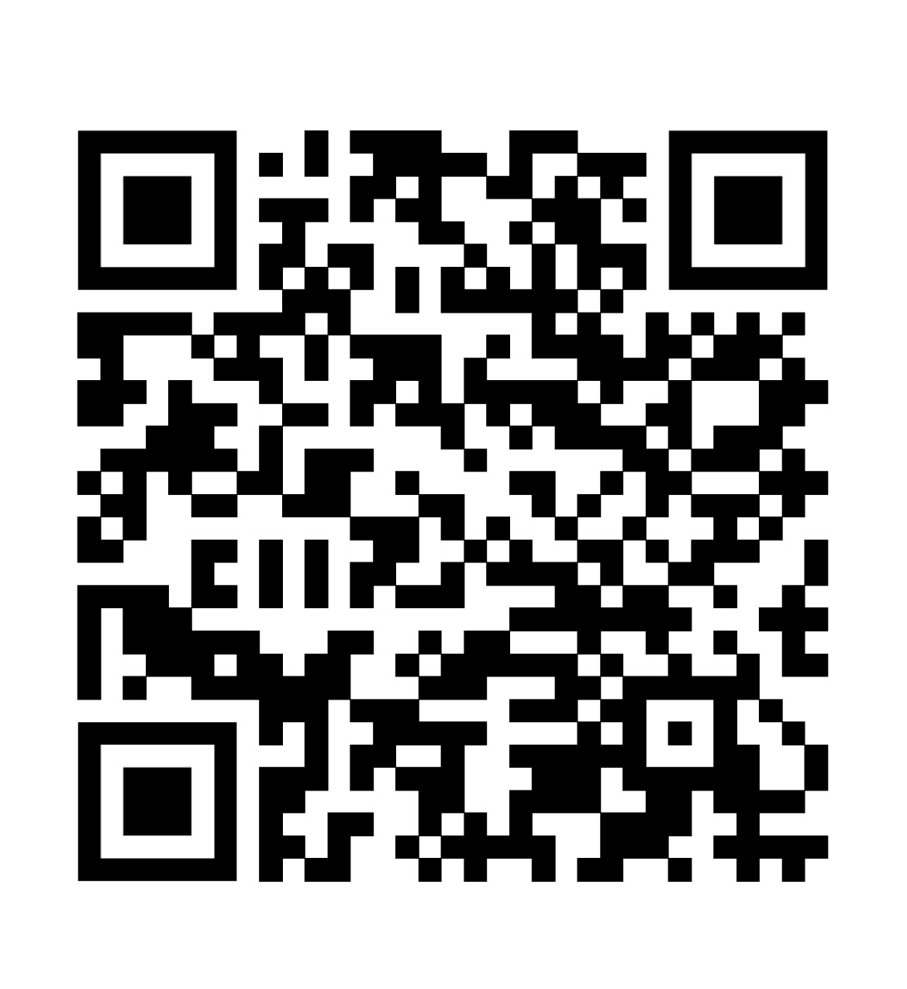
Resources &
Contacts
https://unsdgopff.opened.ca/
https://kpu.pressbooks.pub/unsdgtoolkit/
https://tru.arcabc.ca/islandora/object/unsdg%3Aroot
Dr. Michael Mills
Michael.Mills@montgomerycollege.edu
@drmichaelmills
Dr. Shinta Hernandez
Shinta.Hernandez@montgomerycollege.edu
@profhernandez2
Notes:
Mike

Slide 15


