Slide 1

WELCOME!
Signature Work: Who Needs it in the Digital Age?
Terrel Rhodes
VP, Quality, Curriculum and Assessment

Slide 2
Re-Imagining Higher Education General Education
Institutional Intentionality
Curriculum Design
Changes in Faculty and Staff Roles
Changes in Student Roles

Slide 3


AAC&U Members on Recent Trends in General Education Design, Learning Outcomes, and Teaching Approaches
Key findings from a survey among 325 Chief Academic Officers or designated representatives
at AAC&U member institutions, conducted July 15 to October 13, 2015,
by Hart Research Associates for the Association of American Colleges and Universities
Notes:
11604 Membership Recent Trends Deck
Note: vertical expressions for subgroups except where noted

Slide 4

Profile of the Sample
Carnegie Classification
Associate’s degree
Bachelor’s degree
Master’s degree
Doctoral degree/
research
Other
Affiliation
Public
Private/religious
Proprietary
11%
30%
39%
19%
1%
46%
53%
1%
The survey was conducted among 325 Chief Academic Officers or designated representatives at AAC&U member institutions from a list of 1,001, with a response rate of 32%.
Notes:
From file (at end of FI)

Slide 5
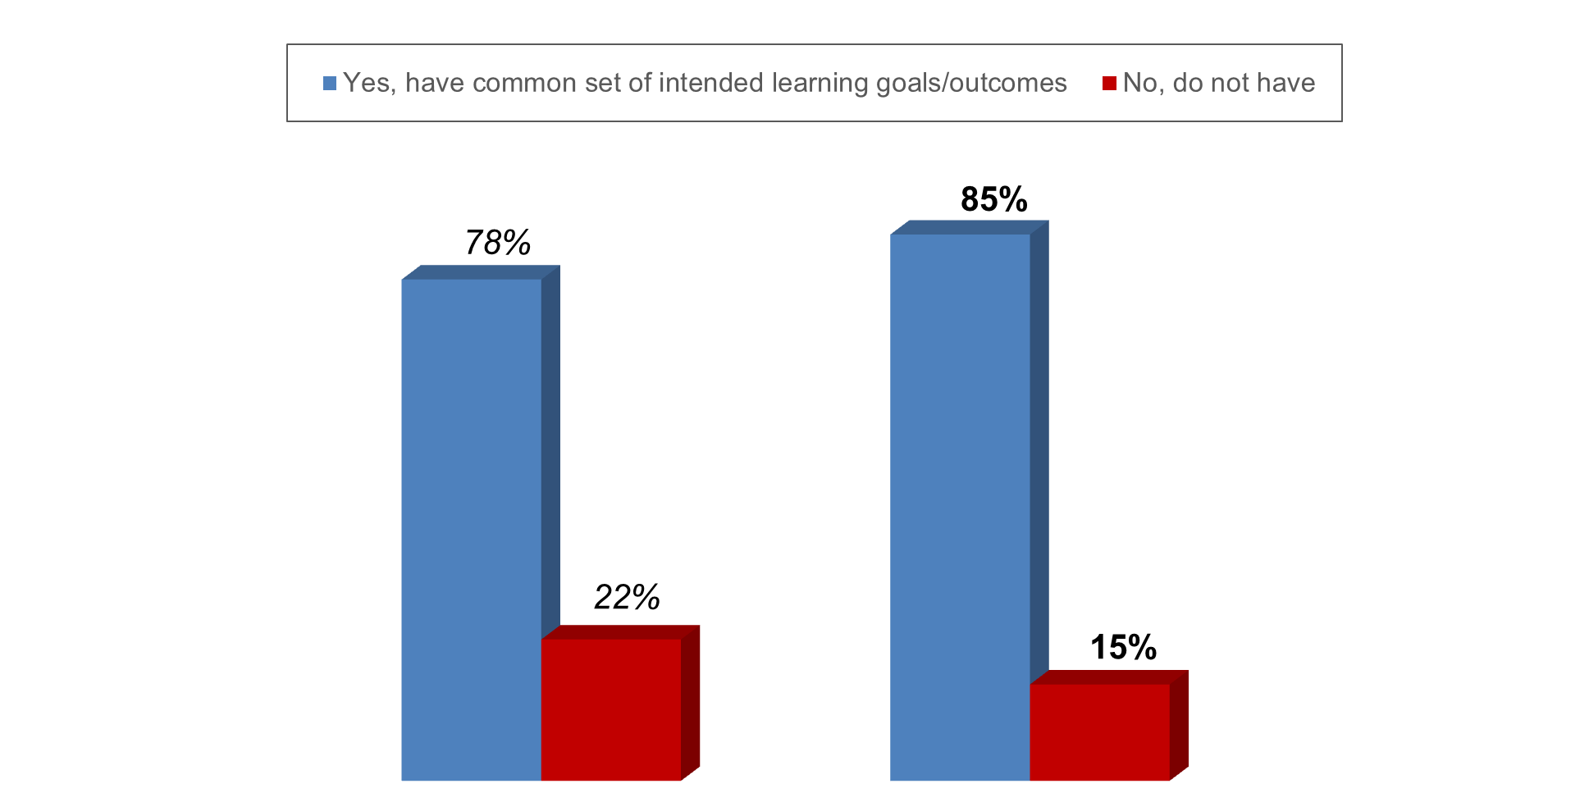
Most AAC&U member institutions have a common set of learning outcomes for all of their undergraduate students.
Does your institution have a common set of intended learning goals or learning outcomes that apply to ALL undergraduate students?
November/December 2008
July – October 2015
Notes:
Q.3

Slide 6
AAC&U members with common learning outcomes have outcomes that apply to a broad range of skills and knowledge areas; significant consensus exists on outcome areas.
Proportions saying their institution has learning outcomes for ALL undergraduate students that address specific skills and knowledge areas*
2015
99%
98%
94%
92%
92%
92%
89%
89%
85%
82%
79%
2008
99%
95%
91%
91%
87%
92%
87%
90%
N/A
88%
79%
Writing skills
Critical thinking and analytic reasoning skills
Quantitative reasoning skills
Knowledge of science
Knowledge of mathematics
Knowledge of humanities
Knowledge of global or world cultures
Knowledge of social sciences
Knowledge of the arts
Oral communication skills
Intercultural skills and abilities
(continued)
* Among members at institutions that have a common set of learning outcomes for all undergraduate students
Notes:
Q.4ab

Slide 7
AAC&U members with common learning outcomes have outcomes that apply to a broad range of skills and knowledge areas; significant consensus exists on outcome areas.
Proportions saying their institution has learning outcomes for ALL undergraduate students that address specific skills and knowledge areas*
(continued)
2015
76%
75%
75%
73%
68%
65%
63%
49%
48%
47%
27%
2008
76%
65%
75%
73%
63%
66%
68%
61%
42%
49%
24%
Information literacy skills
Research skills and projects
Ethical reasoning skills
Knowledge of diversity in US
Integration of learning across disciplines
Application of learning beyond the classroom
Civic engagement and competence
Knowledge of technology
Knowledge of languages other than English
Knowledge of American history
Knowledge of sustainability
* Among members at institutions that have a common set of learning outcomes for all undergraduate students
Notes:
Q.4ab

Slide 8
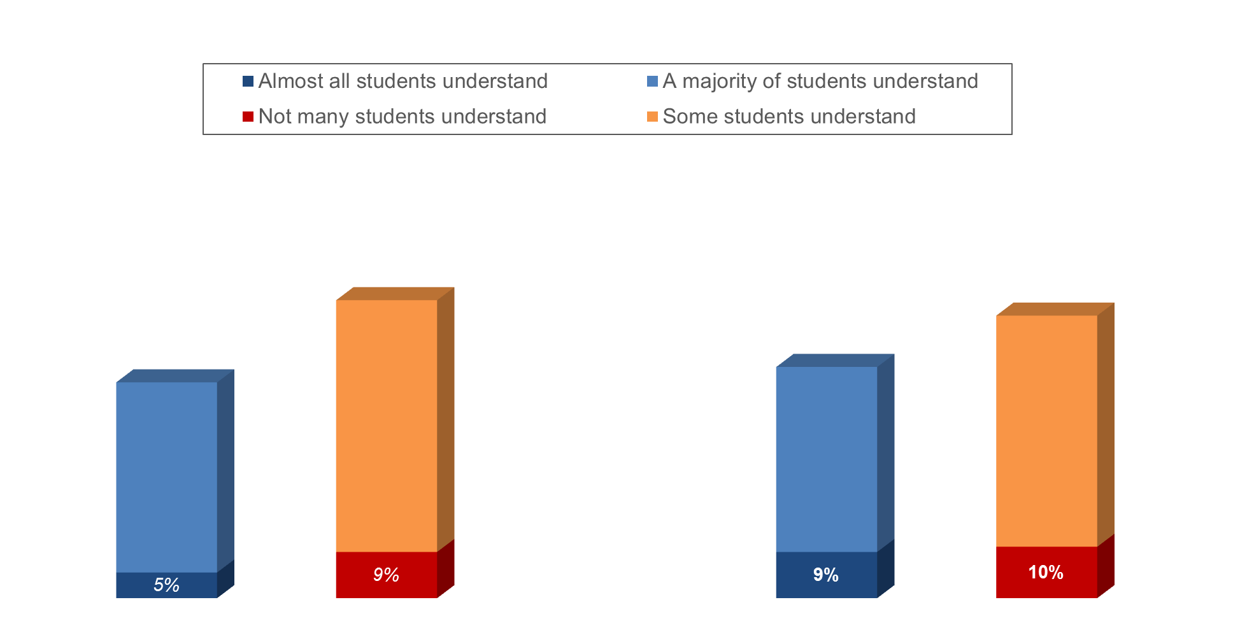
Educational leaders at institutions with common learning outcomes do not report that students have a greater understanding of these goals in 2015 than they did in 2008.
What is your sense of how many of your students understand your institution’s intended learning outcomes for undergraduate learning?*
58%
55%
42%
45%
November/December 2008
July – October 2015
* Among members at institutions that have a common set of learning outcomes for all undergraduate students
Notes:
Q.5

Slide 9
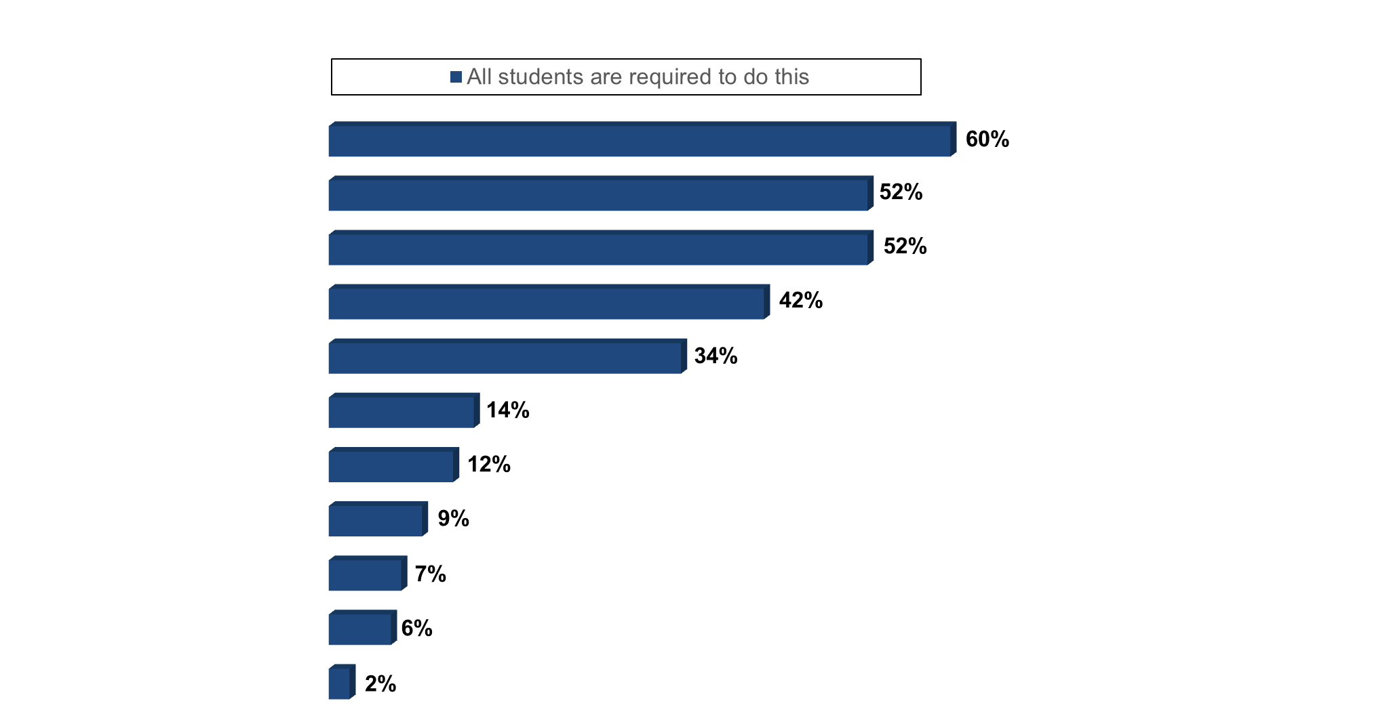
Many institutions are implementing evidence-based practices, and they are most likely to require those that support the successful transition to college.
What approach is your campus taking with regard to these types of learning practices?
This is
offered as
an option
31%
30%
41%
23%
53%
79%
59%
87%
90%
92%
94%
Total
offered
91%
82%
93%
65%
87%
93%
71%
96%
97%
98%
96%
First-year experiences that support transition to college
First-year academic seminars
Global/world culture studies
Orientations to liberal education, purpose/value
Diversity studies/ experiences
Service learning in courses
Learning communities
Undergraduate research
Practicums and
supervised fieldwork
Internships
Study abroad
Notes:
Q.12

Slide 10
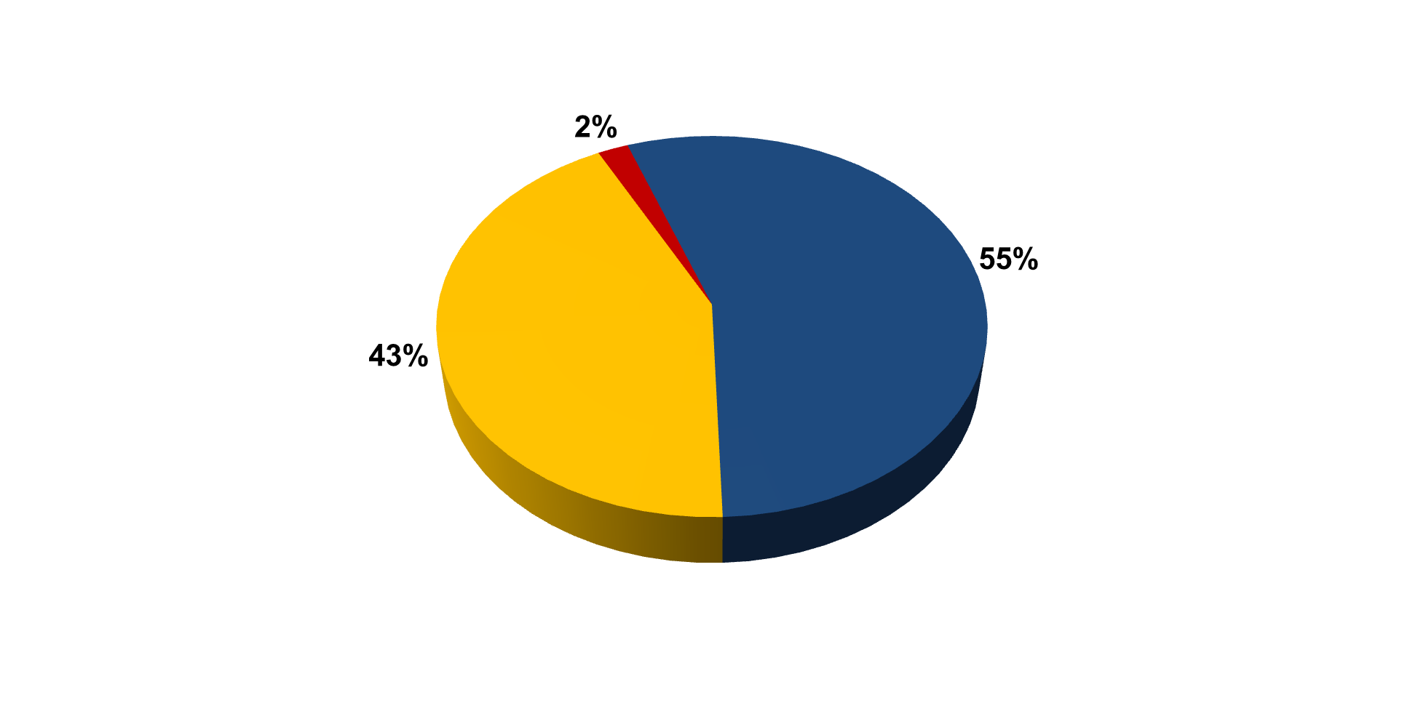
The majority of AAC&U member institutions continue to say that general education is more of a priority than it was five years ago.
How has general education changed as a priority for your institution in the past five years?
Has become less
of a priority
Has become more
of a priority
Has not changed
as a priority
Notes:
Q.19

Slide 11
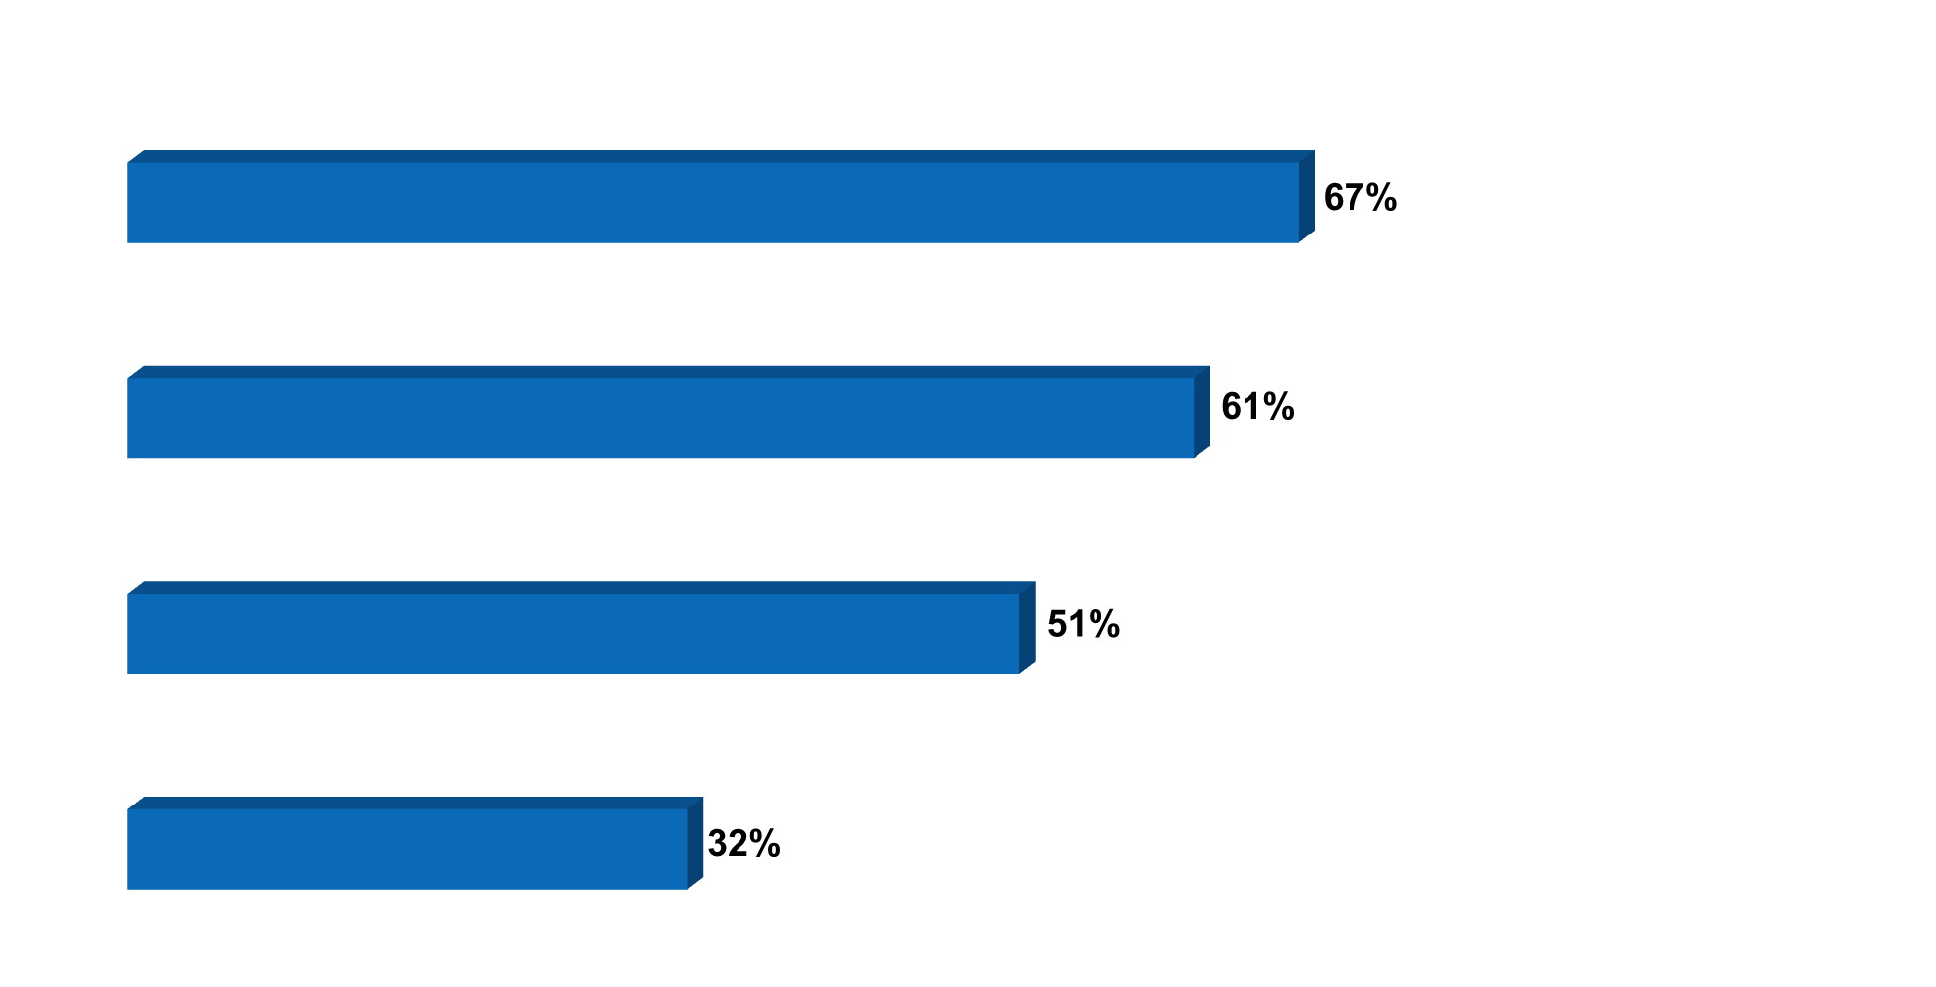
Institutions are placing greater emphasis on integration of knowledge, skills, and application than on broad knowledge acquisition in their general education programs.
Proportions saying their institution is placing more emphasis on each practice in their general education program
Integration of knowledge, skills, and application
Applied learning experiences
Cross-cutting skill development
Broad knowledge acquisition
Notes:
Q.22

Slide 12

Few institutions describe their general education programs as coherent or having structured pathways.
Proportions saying each describes* their institution’s general education program
Coherent sequence of courses and/or educational experiences
2008
35%
N/A
Structured pathways that progressively develop proficiencies in key areas
* 4 + 5 ratings on a five-point scale, 5 = describes the program very well
Notes:
Q.25

Slide 13
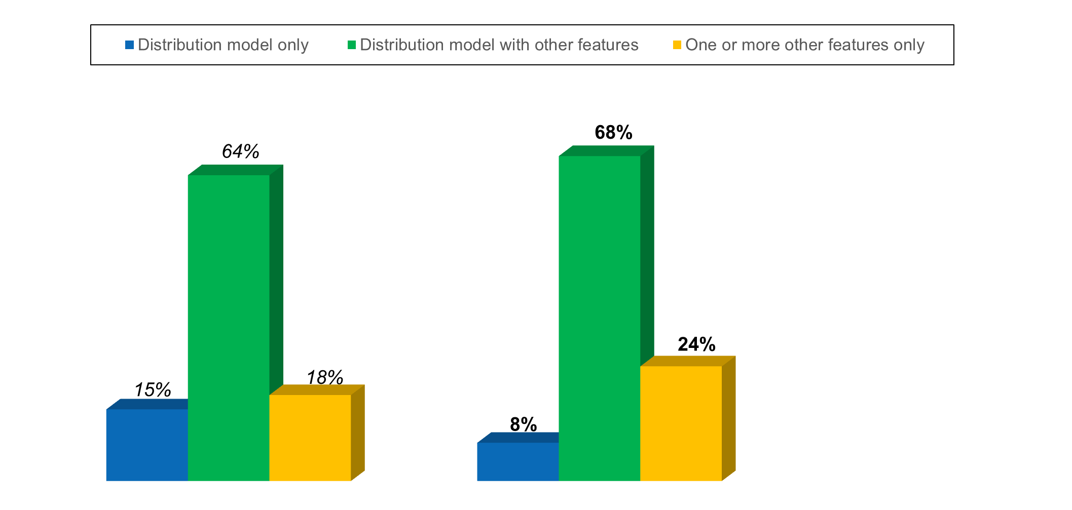
The majority of institutions use a distribution model with addition-al integrative features. Fewer use only a distribution model in 2015 than did so in 2008.
Which of these features are part of your institution’s general education program?
Other features:
Common intellectual experience
Thematic required courses
Upper-level requirements
Core curriculum
Learning communities
November – December 2008
July – October 2015
13
Notes:
Q.20/8797 special run

Slide 14
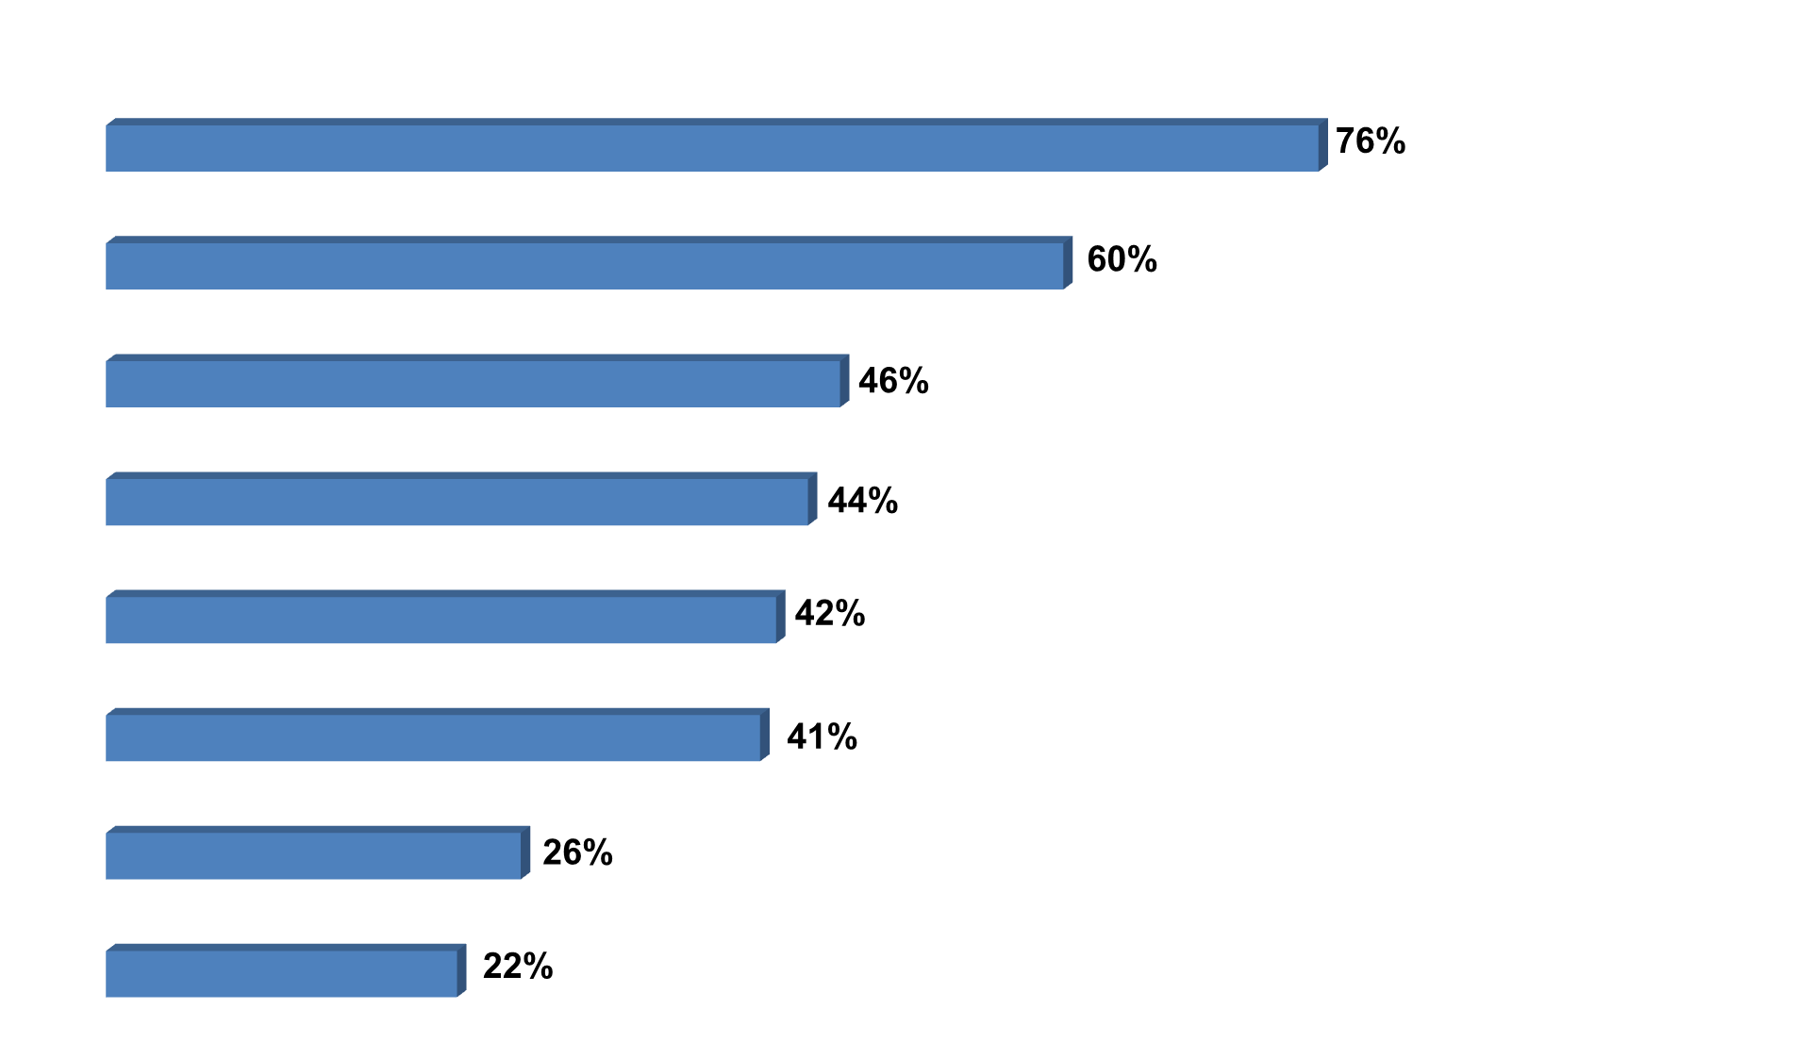
Institutions incorporate various general education program design elements.
Proportions saying each is included as part of their institution’s general education program
Distribution model
Capstone or culminating studies (taken in major programs)
Upper-level general education requirements
Core curriculum
Thematic required courses
A common intellectual experience
Capstone or culminating studies (taken as part of general education)
Learning communities
Notes:
Q.20

Slide 15
Proportions of Member Institutions that Assess Learning Outcomes in Departments
Does your institution assess learning outcomes across the curriculum? If it does, are students’ cumulative learning outcomes assessed in departments?
2008
2015
87%
A few/No
departments
72%
A few/No
departments
68% assess
within departments
85% assess
within departments
28%
Planning
to do so
24%
All/Most
departments
13%
All/Most
departments
Planning to
11%
Assess learning outcomes
Do not assess learning outcomes
Assess learning outcomes
Do not assess learning outcomes
Notes:
Q.7ab

Slide 16
Assessing Cumulative Learning Outcomes in General Education
Does your institution assess cumulative learning outcomes in general education across multiple courses?
November – December 2008
July – October 2015
48%
33%
Planning
to do so
42%
Planning
to do so
25%
Assess learning outcomes
Do not assess learning outcomes
Assess learning outcomes
Do not assess learning outcomes
Notes:
Q.8a

Slide 17
Member institutions use a variety of methods to assess student learning outcomes in general education.
Does your institution assess cumulative learning outcomes in general education across multiple courses?
Which of these does your institution use?
Institutionally created rubrics applied
to samples of student work
Culminating or capstone projects
Student surveys and self-reports
Locally developed common assignments in some courses
Locally developed examinations
AAC&U VALUE rubrics applied to samples of student work
Standardized national tests of general skills, such as critical thinking
Standardized national tests of general knowledge, such as science or humanities
87%
78%
64%
62%
46%
42%
38%
33%
33%
Planning
to do so
25%
Assess learning outcomes
Do not assess learning outcomes
Notes:
Q.8ab

Slide 18
Use of Rubrics to Assess General Education Learning Outcomes Increases; Use of General Skills Tests Decreases
Proportions saying their institution uses each to assess learning outcomes in general education*
Rubrics applied to examples of student work (Institutionally created or AAC&U VALUE)
Culminating or capstone projects
Student surveys and self-reports
Locally developed common assignments in some courses
Locally developed examinations
Standardized national tests of general skills, such as critical thinking
Standardized national tests of general knowledge, such as science or humanities
2008
77%
70%
67%
52%
44%
49%
31%
* Among members at institutions that assess cumulative student learning outcomes in general education (87%)
Notes:
Q.8b

Slide 19
THE LEAP CHALLENGE, General Education AND SIGNATURE WORK

Slide 20
SOME CONTEXT
Signature Work
  What is it?
  Why is it important?
How Signature Work connects to guided learning pathways

Slide 21

What is
the LEAP Challenge?

Slide 22
Integrative and Applied Learning—
”The 21st-Century Liberal Art”
Synthesis and advanced accomplishment across general and specialized studies . . .
. . . Demonstrated by applying knowledge, skills, and responsibilities to new settings and complex problems.

Slide 23
Faculty/Staff/Educational Professionals
Conveyor
My Work
Preeminence of Content/Major
Privilege - Lower order skills/abilities
Coverage
Episodic
Mentor
Our Work
Preeminence of Inquiry and Discovery
Privilege – Higher order skills/abilities
Knowing
Iterative

Slide 24
Admiring the Problem or
Equity-Mindedness
Move from deficit model to a value model
We all speak as a minority person – with or without privilege
Look at the Data [Gates – Answering the Call for Better Data]
Engagement has disproportionately positive effect on least advantaged student learning, persistence and completion
Move from mind set: Is student college ready? to is college student ready?

Slide 25
Digital
Ubiquitous
How we live; how our students live
Here to stay
Efficient delivery; necessary, but not sufficient
Facilitates learning knowledge and practice
Expands demonstration of learning
Enhances collaboration and integration – potentially – ePortfolio as framework
Requires mentorship

Slide 26
We have had our why's, how's, and what's upside-down,
focusing too much on what should be learned, than on how, and
often forgetting the why altogether.
In a world of nearly infinite information, we must first
address why, facilitate how, and let the what generate
naturally from there.
Michael Wesch, “From Knowledgeable to Knowledge-able,” Academic Commons, January 2009 (academiccommons.org)

Slide 27
Signature Work
In Signature Work, students
  integrate, apply, demonstrate, reflect on, and communicate their cumulative learning in a project or activity lasting at least one semester, in which they
  grapple with complex questions that matter, and which require input from multiple disciplines and perspectives.

Slide 28
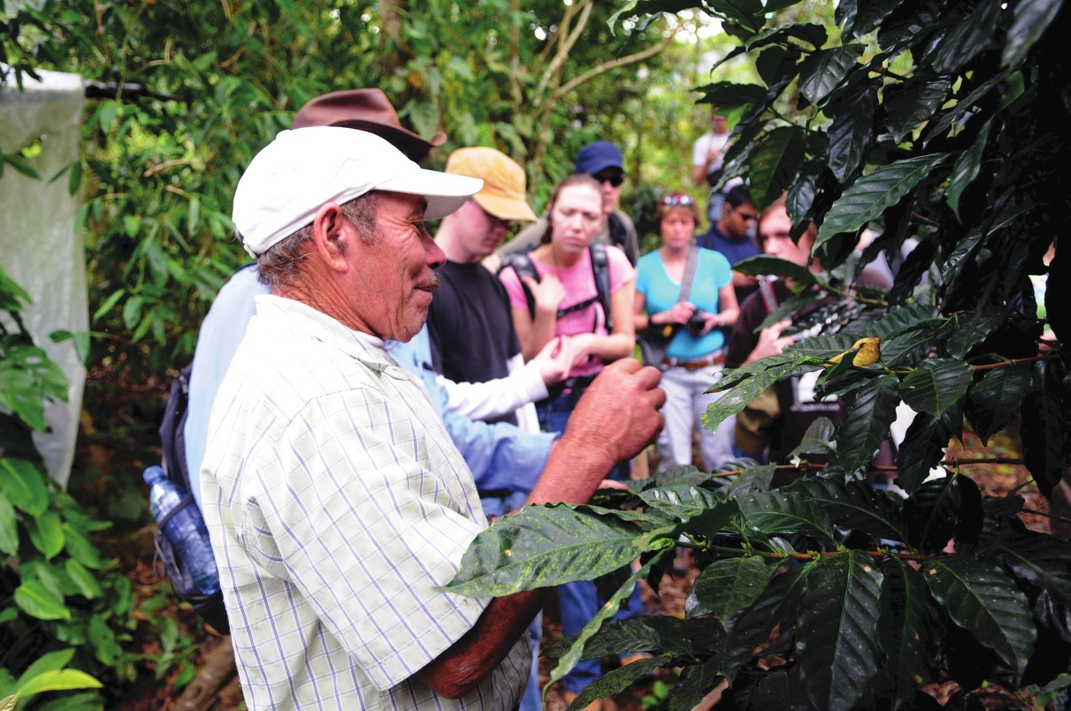
Knowing, Connecting, Doing
Signature Work connects students’ pressing questions with action-oriented research and practice, turning nouns (learning outcomes) into verbs (what students can do with what they’ve learned).

Slide 29
Why “signature”?
Students are mentored, but they take the lead in defining the issue on which they want to focus, and in communicating its significance.
The project should emerge from students’ questions, interests, and commitments, so they are motivated to take responsibility for the quality of their efforts.

Slide 30
Signature Work and High-Impact Practices
First-Year Experiences
Common Intellectual Experiences
Learning Communities
Writing-Intensive Courses
Collaborative Assignments and Projects
Undergraduate Research
Diversity/Global Learning
Service Learning, Community-Based Learning
Internships
Capstone Courses and Projects
ePortfolios

Slide 31
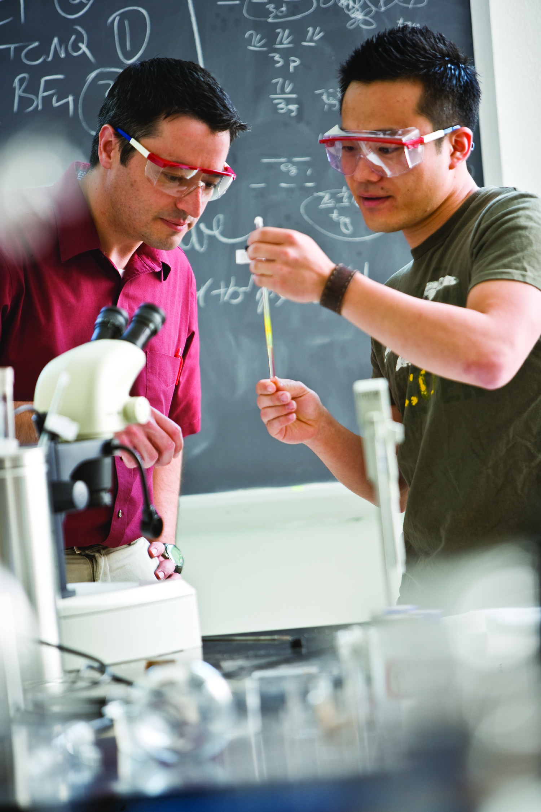
Elements of Signature Work
First Year Seminars
Research projects
Creative endeavors
Practica, internships, service learning--with reflection
Assignments connected across a thematic range of courses, co-curricular experiences, and/or community engagement opportunities
Capstone inquiry experiences

Slide 32
Signature Work Matters Because . . .
Integrative, applied, and reflective learning are positively associated with student growth in
  Critical thinking skills
  Moral reasoning ability
  Inclination toward lifelong learning
    Pascarella and Blaich, “Lessons from the Wabash National Study of Liberal Arts Education,” 2013

Slide 33
Signature Work Matters Because . . .
Engaged at work = Great Jobs and Great Lives:
  Thirty-nine percent of college graduates are engaged at work.
  Fifty-four percent are thriving in purpose well-being; 49% are thriving in social well-being, 47% in community well-being, 42% in financial well-being, and 35% in physical well-being. Only 11% of college graduates are thriving in all five elements of well-being. More than one in six graduates are not thriving in any of the elements.
  As many graduates from the Top 100 U.S. News & World Report schools are engaged in their work as graduates from other institutions.
  There were no differences in employee engagement by race or ethnicity, or by whether the graduate had been the first in the family to attend college.
  (Gallup Purdue Index Report 2014)

Slide 34
Signature Work Matters Because . . .
The odds of being engaged at work are:
  1.9x Higher if I had a mentor who encouraged me to pursue my goals and dreams.
  1.8x Higher if I had an internship or job that allowed me to apply what I was learning in the classroom.
  1.7x Higher if I worked on a project that took a semester or more to complete.
  (Gallup Purdue Index Report 2014)

Slide 35
Signature Work Matters Because . . .
The odds of strongly agreeing education was worth the cost are:
  1.9x Higher if I had a mentor who encouraged me to pursue my goals and dreams.
  1.6x Higher if I worked on a project that took a semester or more to complete.
  1.5x Higher if I had an internship or job that allowed me to apply what I was learning in the classroom.
    (Gallup Purdue Index Report 2015)

Slide 36
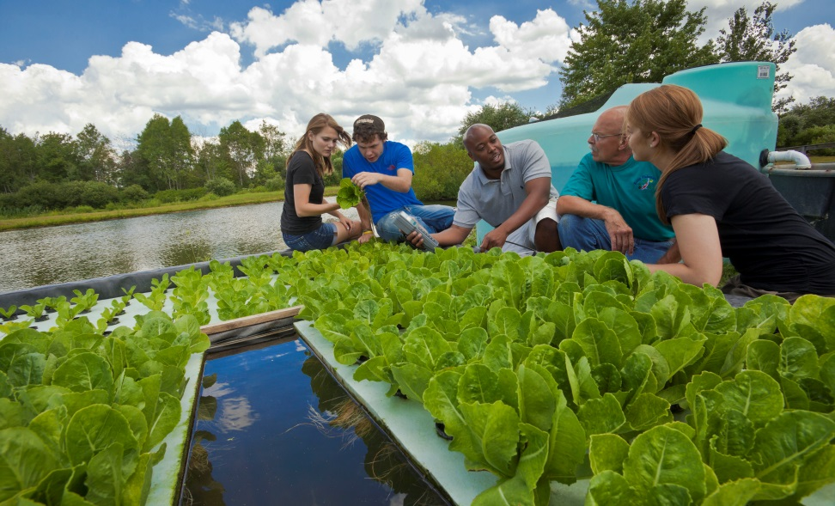
Signature Work Matters Because . . .
We need graduates with the capacity and commitment to address complex problems in their personal and civic lives, and in their workplaces.
Notes:
lysis, and communication, and who have a clear sense of personal and social responsibility, so they can contribute in important ways in all facets of their lives.

Slide 37
How Are Students Prepared to Accomplish Signature Work?
Through guided learning pathway curricula and co-curricular experiences, in which they can develop and connect their knowledge and skills across broad and specialized study, and over time.

Slide 38

General Education Maps and Markers
Designing Meaningful Pathways to Student Achievement
Notes:
Maps and Markers: describe some optimal routes to the goal of learning outcomes, and identify some milestones to measure progress toward the goal.

Slide 39
Essential Learning Outcomes
Signature Work
Assessment and Rubrics
Notes:
The GEMs principles are guidelines for a comprehensive reform of undergraduate education; beginning with general education, but not ending there.

Slide 40
GEMs Curriculum Design Principles
Proficiency:
  Explain what you want students to know and be able to do; map the curricula to those goals; and scaffold assignments so that students develop their knowledge and skills over time.
    Signature Work demonstrates proficiencies.

Slide 41
GEMs Curriculum Design Principles
Agency & Self-Direction:
  Ensure that students have a voice in planning their journeys through the curriculum and co-curriculum; that they are completing work that is relevant to them; and that they are given time to reflect on their learning.
    Student motivation (with faculty guidance) drives Signature Work.

Slide 42
GEMs Curriculum Design Principles
Integrative Learning & Problem-Based Inquiry:
  Design the curricula so that students’ experiences and learning in all contexts are connected, and provide them with a chance to apply knowledge and skills from multiple areas to real-world problems.
    Signature Work is integrative and addresses a complex question or questions.

Slide 43
GEMs Curriculum Design Principles
Equity:
  Ensure that all aspects of your quality liberal education (including opportunities to complete Signature Work) are accessible to all students, and that all have an equal opportunity to succeed.
    All students should have an opportunity to complete Signature Work, and be equitably prepared to do so.

Slide 44
GEMs Curriculum Design Principles
Transparency & Assessment:
  Make sure that all of your constituents are aware of what the institutional learning outcomes are, and how you know whether or not students are achieving them.
    Signature assignments, clearly designed with institutional learning outcomes in mind, can be excellent sources of evidence for student achievement.

Slide 45
A Few Examples of Research or Study Questions
How do students represent new learning to themselves?
What kinds of learning obstacles impede students from interpreting, analyzing, or synthesizing?
How well do stand alone skills based courses, such as mathematics or writing courses, prepare students to integrate or apply those skills into disciplinary courses?
How do students’ levels of cognition affect their conceptual development?

Slide 46
What kinds of conceptual or computational obstacles inhibit students from shifting from one form of reasoning to another form, such as from arithmetic reasoning to algebraic reasoning? (why does x=y?)
What kinds of representational models do not develop complex conceptual understanding?
What and why are students unable “to see”
what we, experts, see?

Slide 47

The Key Elements for a Compelling Quality Framework Already Are in Hand
Consensus Aims and Outcomes
Practices that Foster Achievement AND Completion
Evidence on “What Works” for Underserved Students
Assessments That Raise – and Reveal – the Level of Learning

Slide 48
Main points
Value on student work and voice
Emphasis on using assessment as a means to give student a sense of their capacity
Most importantly, assessment that serves the need of student learning

Slide 49
Faculty and Staff
(and Student)
Collaboration

Slide 50
from My Work
to OUR Work

Slide 51
The LEAP Challenge:
Making Signature Work a goal for all students, and the expected standard of quality learning in college.

Slide 52
Positioning Integration in the Student’s Experience
One of the great challenges in higher education is to foster students’ abilities to integrate their learning across contexts and over time. Learning that helps develop integrative capacities is important because it builds habits of mind that prepare students to make informed judgments in the conduct of personal, professional, and civic life; such learning is, we believe, at the very heart of liberal education.
~Mary Taylor Huber and Pat Hutchings
Integrative Learning: Mapping the Terrain (2005)

Slide 53
Prior Learning Questionnaire
Rationale:
Teaching and Orientation
Assessment as information
Transformative power of observation
Knowing our students
“Not a bunch of 18 year old” Insight

Slide 54
Prior Learning Questionnaire
How does this assessment serve the 3 constituencies?
Student, institution, program (faculty)

Slide 55
Prior Learning Questionnaire
Student (Programmatic/Institutional)
Who are our students: Age, gender, background, concerns, difficulties, challenges, academic preparedness
Experience with the goals of the course, writing, public speaking, working in groups, diversity, Community based learning
Fears, hopes, reasons for being here, etc

Slide 56
Prior Learning Questionnaire
Focus student attention and awareness on:
Why am I here?
Who are my peers/community?
What are our goals (course/general)
What are my fears/obstacles?
What are my resources?

Slide 57
Prior Learning Uses
Quantitative Literacy Exercise
Programmatic Improvement
Classroom and Curriculum Improvement
Community Building

Slide 58
Early Term Questionnaire
Rationale:
Student voice
Opportunity to influence the direction of the course
Student ownership

Slide 59
Early Term Questions
Give one or two examples of what it is really helping you learn in this class?
Give one or two examples of specific things that make it difficult for you to learn?
Suggest one or two specific practical changes that your instructor or your mentor could make that would improve your learning in this class?

Slide 60
Early Term Impact Study
Study looking at the impact of the early term questionnaire on student learning
Compared students who felt concerns addressed with those who did not on:
  Student satisfaction with the course
  Satisfaction with Instructor
  Satisfaction with mentor

Slide 61
Early Term Impact Study

Slide 62
Examples of How Early Term Assessment Used
Changes in curriculum
Changes in work-load, time given
Change in timeliness and type of feedback
Opportunity for discussion with students about their learning

Slide 63
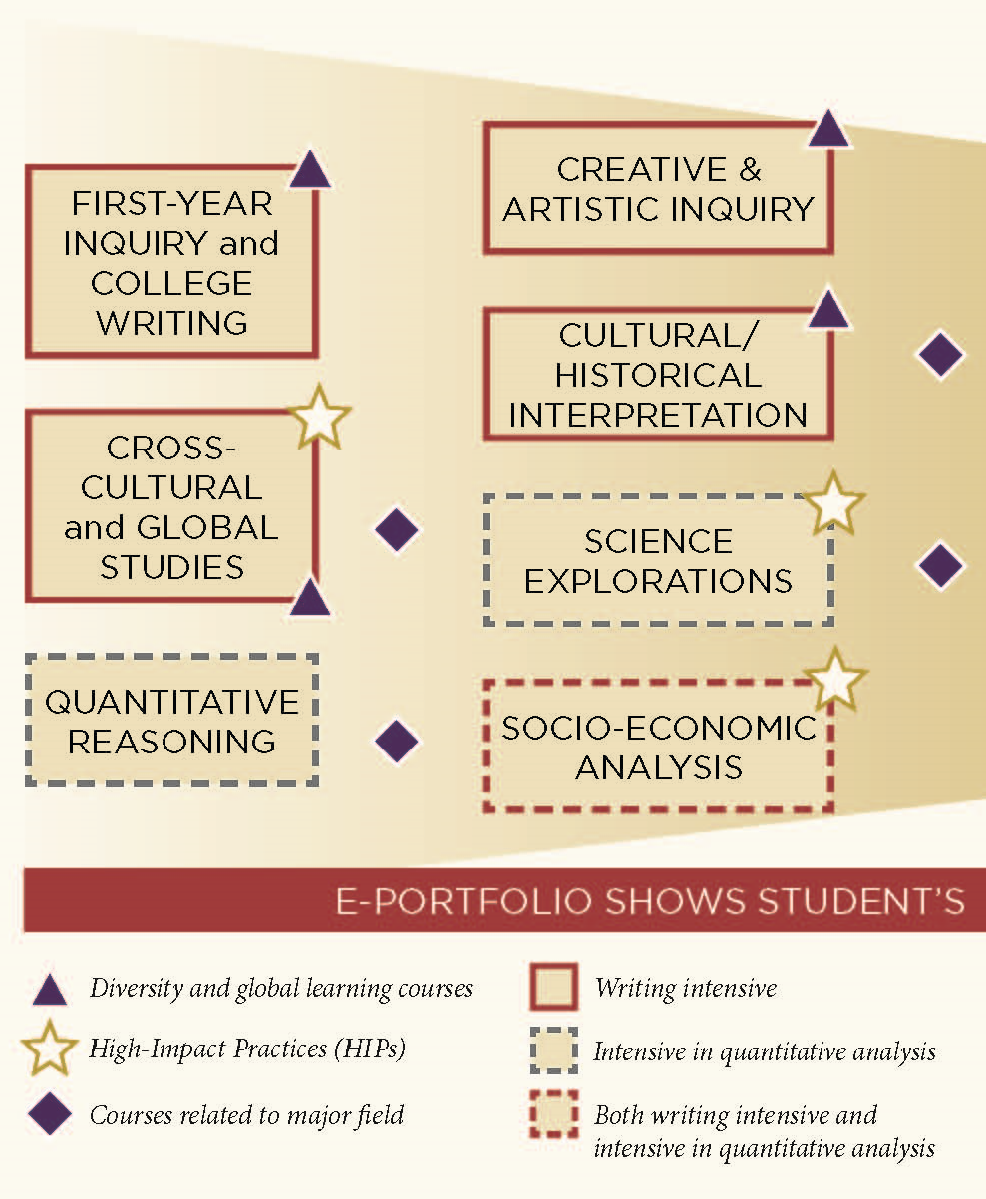
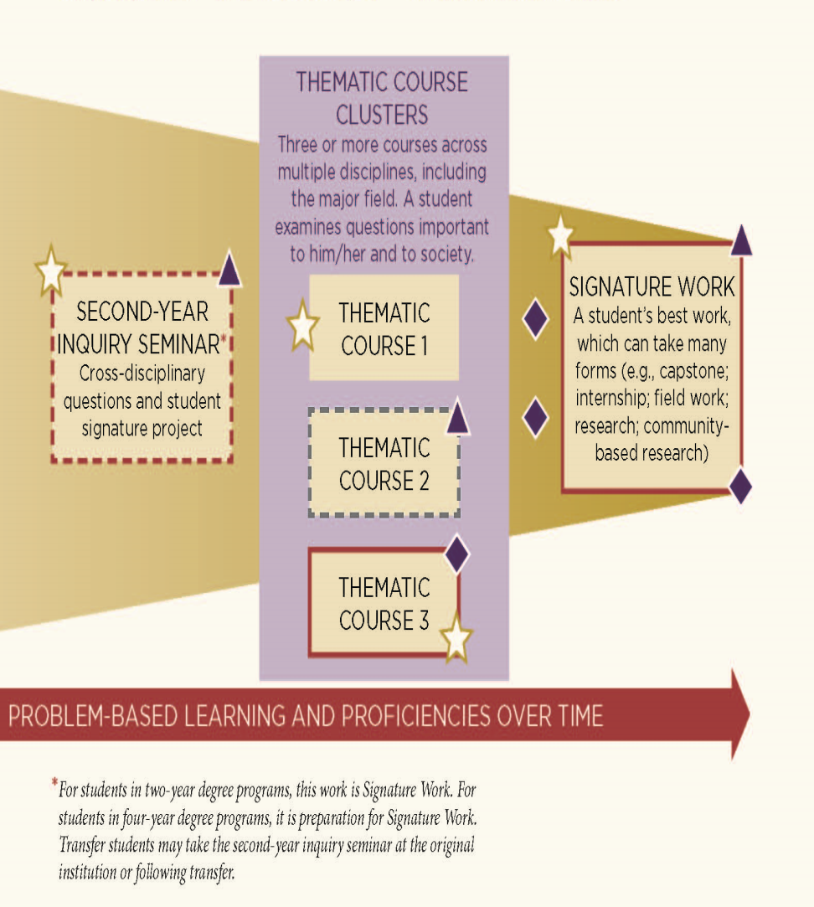
A Guided Curricular Pathway

Slide 64
Campus Examples of Best Practices
Portland State University
  Learning communities, writing requirement, senior capstone
  Freshman inquiry, Soph inquiry, upper division cluster, senior capstone
University of Maryland
  CIVICUS – interdisciplinary courses in collaboration w/ student life & library
University of Nebraska-Lincoln
  GE credits in the curriculum and co-curriculum (particularly for civic engagement)
Texas A&M
  Made civic engagement part of accreditation Quality Enhancement Plan
  Campus-wide visibility
CSU-Monterey Bay
  Civic Literacy across the curriculum
  CSU-Sacramento
    Faculty learning communities

Slide 65
Learning – Integrative and Problem-Based
What students can do with knowledge and experience
Portable, significant and connected - ePortfolios
Well-structured knowledge (skill and drill), plus ill-structured knowledge (problems, complex, no one answer – identify/define the problem)
Hard skills (memorization, calculation) and Soft skills (critical thinking, teamwork, ethics, equity) = Essential skills
Learning is social (individuals learn; learning is a shared enterprise)
Meaning-making and authorship – signature work (generators of knowledge)
Benchmarks (transparency/assessment) – local and nationwide

