Slide 1
Innovating First-Year Composition
Utilizing Open-Educational Resources (OER) and Introducing Open-Educational Pedagogies (OEP) in a First-Year Composition Course at a Historically Black College or University
by Mari-jo Ulbricht
Notes:
OER are learning materials in the public domain or openly licensed to permit the 5 R’s reuse, revision, remixing, retention, and redistribution. OEP is using OER to make the educational experience more meaningful by implementing innovations made possible by OER.

Slide 2
Problem of Practice
Students in 1st-year composition courses at an HBCU now have an OER digital E-text that replaces our traditional print text yet writing instruction must also change to be relevant for a digital environment.
Writing instruction for communicating in a virtual environment must be central to the HBCU setting in that increasing students’ digital literacies for academic purposes will further their readiness for both scholastic and professional pursuits.
My action research study is significant in that it examined the role of OER/OEP in supporting students’ writing for a digital environment by innovating pedagogy in the context of the HBCU composition classroom.
Notes:
Initially our department adopted OER to replace expensive textbooks as many students would not purchase one. OER levels the playing field as the text is available from day one, can be downloaded on any device. My goal was to understand how instruction should evolve so that I am not teaching as if the only change was the transition from a print text to an E-text.

Slide 3


Research Question
This action research study examined the shifting landscape of writing instruction and the role of OER/OEP in the HBCU composition classroom. The research question and sub-question underlying this investigation were:
In what ways does utilizing OER innovate teaching and learning for instructor and students in a first-year composition course at an HBCU?
  How can OEP enhance the use of OER in a first-year composition course at an HBCU?

Slide 4
Literature Review (continued)
The Teaching and Learning of Writing in the HBCU
Strengthening Writing, Reading, & Digital Literacies
Writing Skills Development (K. Anderson et al., 2017; Gile, 2020; Griffin et al., 2019; Jin et al., 2017a)
Writing Anxiety (McAllister et al., 2017; Rauch, 2020)
Reading-Writing Connection (Mongillo & Wilder, 2012; Rauch, 2020)
New Literacies (Evans, 2012; Mongillo & Wilder, 2012)
Valuing Students’ Identity, Language, and Culture
Culturally Relevant Curriculum (Anokye, 2020; Green, 2016; Handa et al., 2013; Mitchell, 2016; Pitts, 2017)
Students’ Right to Their Own Language (Anokye, 2020; Handa et al., 2013; Mitchell, 2016)
Notes:
This strand emphasizes two key themes: 1) prioritizing the enhancement of students' writing proficiency crucial for the success of HBCU students, and 2) challenging traditional approaches that focus solely on grammar correctness. A deficit perspective of writing assessment should be abandoned since it disproportionately affects non-traditional, first-generation, and also African-American male students, leading to writing anxiety. This aligns with my study's approach of rethinking assessment through multimodal projects and culturally relevant curriculum that incorporates social justice issues to foster critical awareness.

Slide 5
Literature Review (continued)
OER/OEP and its Role in Supporting Writing Instruction
The Open Education Movement Toward Student Access, Equity, and Success (Colvard et al., 2018; Weller et al., 2015)
The Role of OER/OEP in Supporting Writing Instruction (Bloom, 2019; Cronin, 2017; Tillinghast, 2020b)
Notes:
Several studies noted the many benefits of OER for students, from cost-savings to accessibility, increased engagement, and improved academic success. Several authors stressed a shift towards focusing on innovative OEP. Students can be producers and co-creators of knowledge.

Slide 6
Theoretical Framework
Social Learning Perspectives
Social Constructivism (Vygotsky, 1978) Understanding is developed through interaction with others
New Literacies (New London Group, 2000) Stresses the deictic nature of literacy due to rapidly changing technologies with new social practices
Multimodal Literacies (Kress, 2000) Language and literacy practices combine two or more modes of meaning
Critical Literacy (Freire, 1978) Considers the relationship between language and power
Notes:
My study is informed through the lens of social learning perspectives which stress that social interaction is crucial to the development of literacy learning. Social Constructivism – interaction with others is central to learning. New Literacies expands the idea of literacy beyond print and suggests students need 21st century skills to communicate in a digital environment, Multimodal Literacies –multimodal assignments leverage a variety of media formats which was important to my study since traditional writing instruction is insufficient for the 21st century. Critical Literacy means teaching students to question and examine their world – awareness of social justice issues is important in the HBCU setting.

Slide 7
Methodology: Design as Process
Action Research: solve a problem of practice at the local level (Herr & Anderson, 2005; Nickoson & Sheridan, 2012; Sagor & Williams, 2017). Practitioner Research: inquiry and action to improve writing instruction in my first-year HBCU composition classroom with a timeline of Summer Semester 2022- Fall Semester 2022.
Cycle 1 Clarify Vision: plan, prepare, analyze Syllabus and course material
Cycle 2 Articulate Theories: consider what is known re OER/OEP and writing instruction
Cycle 3 Implement Action: infuse OER/introduce OEP, gather data
Cycle 4 Reflect/Plan Informed Action: analyze data/determine needed revisions
Notes:
AR is ongoing recursive cycles of planning, implementing, and reflecting.. AR aims to address practical issues through these iterative cycles. It emphasizes emergent design, meaning that the research evolves and adapts based on ongoing data collection and analysis. The ultimate goal is to bring about positive change in the educational context.

Slide 8
Findings Indicate OER/OEP:
highlights the social nature of writing
signifies the value of students’ active engagement within a diverse and supportive community of peers
promotes culturally responsive pedagogy
actively engages and challenges students through a culturally relevant curriculum that addresses social justice issues
supports the writing process
opens possibilities for a student-centered experience
Scaffolds with customizable materials and hands-on practice including interactive multimodal activities to build confidence
Provides accessible materials, differentiates learning, and empowers students with agency as they engage in co-creating and producing knowledge through alternative assessments.
Notes:
Through the process of data analysis, I identified the emergence of four overlapping themes. Findings indicate that embracing OER/OEP …

Slide 9
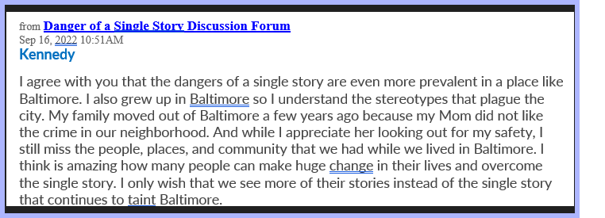
Data: Social Nature of Writing
Kennedy’s Post: Danger of a Single Story Discussion Forum
Notes:
Students watched Adichie's TED Talk, "Danger of a Single Story" (2009), and engaged in a discussion forum where they analyzed its role as a counter-narrative and connected the message to contemporary stereotypes. They supported each other by acknowledging, affirming, and responding to peers' posts. Similar to reflective listening in verbal conversations, students, like Kennedy, reiterated their classmates' points to enhance clarity and coherence in writing. While online discussion forums aren't OER, using participatory technologies for interaction around OER demonstrates OEP. Although discussions can occur without OER, the digital format's accessibility, coupled with virtual discussions, has advantages such as inclusivity and accessibility, aligning with the mission of HBCU to ensure everyone's voice is heard, including those from historically marginalized communities.

Slide 10
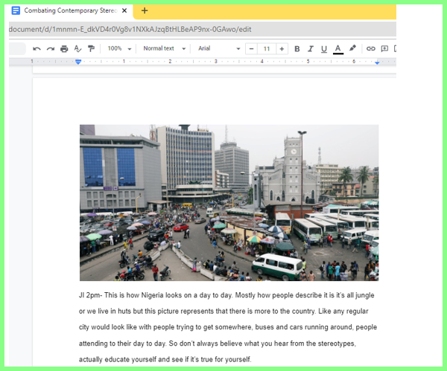
Data: Social Nature of Writing (cont.)
Jamal’s Post: Danger of a Single Story Part 2
Notes:
In “Danger of a Single Story Part 2,” students extended their work1 by connecting principles they learned from Adichie’s talk with popular culture +They now reused and remixed a Creative Commons picture, adding it to their writing to bring a new dimension to it in a shared writing space, a Google Doc on combatting contemporary stereotypes related to faulty beliefs based on gender, ethnicity, nationality, etc. Jamal’s rhetorical analysis of the Creative Commons picture he chose counteracts the ethnocentric beliefs people maintain regarding the inhabitants of Nigeria, often portrayed as impoverished and living in huts. In contrast, he takes aim at those generalizations with this picture highlighting the vibrant and modern city life in Nigeria.

Slide 11
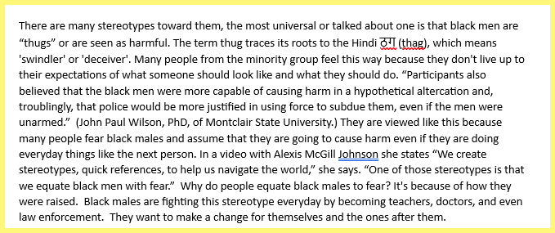
Data: Culturally Responsive Pedagogy
Excerpt from Katie’s Illustration Essay
“That [TED Talk] influenced some things I had to say about what I wrote about in the essay. Then I was reading other articles about stereotypes and stuff like that. So that really changed it because I knew some of the stuff I was writing about. I actually read it and learned more and how in-depth it goes. It was just real eye-opening. It was nice to do.” (Follow-up Interview, Katie)
Notes:
One way to ensure Culturally Responsive Pedagogy (CRP) is to include SJ issues. Building on the theme of "single stories" discussed in the Narrative Unit, I offered students another option in addition to the choice of topics in the standard Illustration Essay assignment instructions. They could expand their work in DSS DF by examining a specific contemporary stereotype in popular culture and analyzing how it is reinforced in the media or the entertainment industry. The five participants who selected this option experienced a deeper engagement with the subject matter they had addressed in previous discussion forums.

Slide 12
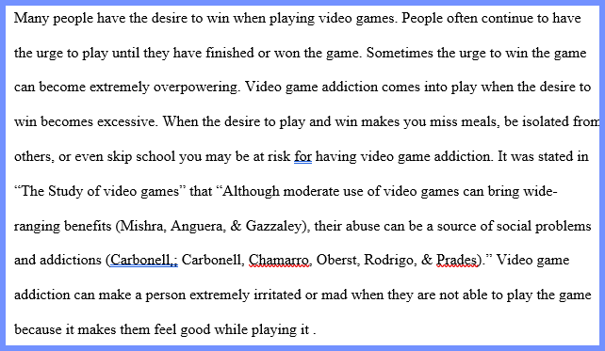
Data: Culturally Responsive Pedagogy (cont.)
Excerpt from Kaia’s Cause/Effect Essay
Notes:
Another way to ensure CRP is to choose culturally relevant content. Including samples of writing to reflect the experiences and perspectives of students can enhance cultural relevance in the course. It helps students see themselves represented in the texts, which can increase their engagement and motivation to learn. For instance, I had included an assignment to analyze an OER student sample Cause/Effect Essay on video game addiction. Kaia chose to write her own Cause/Effect on this topic, which aligned with her interests.

Slide 13
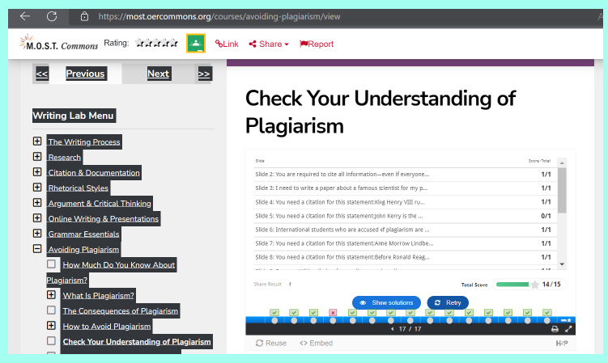
Data: Supports the Writing Process
Excerpt From Cavon’s “Avoiding Plagiarism Tutorial” Results
Yeah, what I liked about using OER is that it broke it down for you, like step by step. or like when we're using the avoiding plagiarism, like what does that mean - plagiarism, and it's something you can go back to when you need it so that you can review when you're doing other stuff later, down the line when you're writing. (Jennifer, Follow-up Interview)
Notes:
I chose multimodal OER activities like tutorials and hands-on practices, providing real-time feedback for low-stakes, formative assessments. This approach allowed students to retry if needed and reinforced their understanding. I also structured scaffolded assignments to offer support at various writing process stages, covering topics like topic sentences, research, MLA format, and grammar. An example is the Avoiding Plagiarism Tutorial from an OER Online Writing Lab (OWL), addressing plagiarism through interactive activities. Students often begin a semester with a hazy idea of what plagiarism entails. This tutorial provides comprehensive instruction and activities on recognizing and avoiding plagiarism. Students engage with an in-depth topic that has been divided into smaller, more manageable units for learning, which they appreciated as Jennifer noted. While scaffolding also occurs in classrooms without OER, integrating OER/OEP in a digital environment offers conveniences; it is indispensable for supporting learning through customizable materials and hands-on multimodal activities.

Slide 14
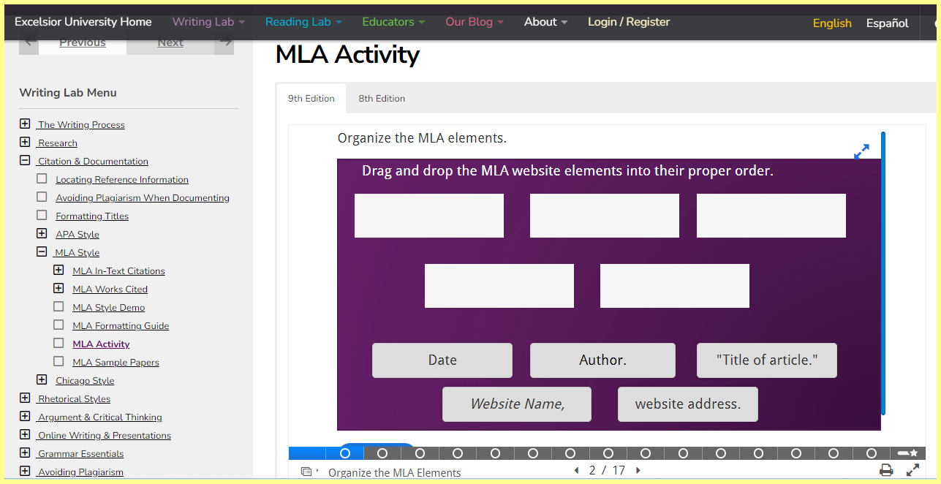
Data: Supports the Writing Process
Excerpt - MLA Activity
Aaron found these types of activities engaging as opposed to passively reading a textbook: “I love hands on …. That's what I'm all about hands-on, rather than reading; I’m just doing it ,,,I actually like doing it then get a walk through when doing it. So that's what I love. (Kennedy and Aaron Follow-up Interview). Kennedy concurred, noting “It just - it's easy to digest as like a learning tool, and it's effective in what it's teaching … “It was interactive and it makes everything better” (Kennedy and Aaron Follow-up Interview).
Notes:
I also included an MLA tutorial with activities embedded within it. Since it is difficult to think of a drier lecture than one on MLA format, I sought multimodal OER that would refresh the rules and strengthen students’ understanding while holding their interest. While very few people may have MLA rules memorized, this resource offered not only a guide to formatting, but also an MLA checklist that students could download and save as a reference when writing their upcoming paper. This multimodal lesson contained an assortment of activities including multiple choice as well as “drag-and-drop” exercises where they were asked to correctly order the elements in a citation. Students’ comments showed that fun and learning need not be mutually exclusive.

Slide 15
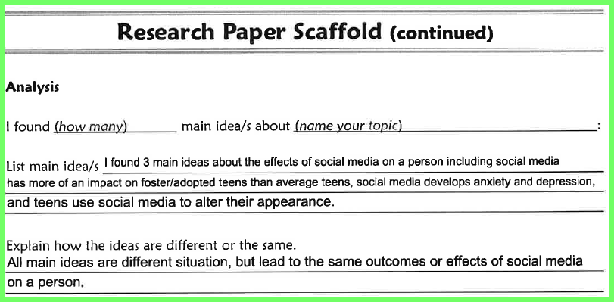
Data: Supports the Writing Process (cont.)
Excerpt From Alayna’s Research Scaffold
Leslie commented on the helpfulness of OER scaffolded assignments: “A research scaffold was one of the tasks, and it demonstrated to us how to use campus resources like the library” (Leslie’s Journal)
Notes:
Students completed a digital Research Scaffold that I obtained from an OER Commons lesson. I reused the original form almost entirely as is but revised the sample APA “Reference” to MLA “Works Cited.” The purpose of this scaffold was to help students find, summarize, and synthesize sources to support their points. It also had the added benefit of acting as a segue to the more formal Annotated Bibliography they will complete in English 102.

Slide 16
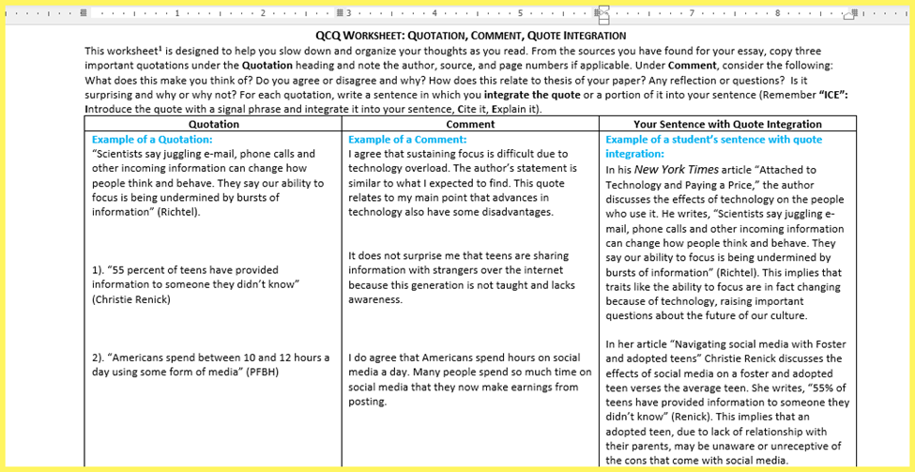
Data: Supports the Writing Process (cont.)
Excerpt From Alayna’s Quotation Integration Practice
Notes:
Subsequently, I selected an OER APA quotation worksheet that I reused and revised in MLA format. The goal was to seamlessly incorporate quotes discovered during research for their Cause/Effect Essay by thinking of the acronym, “ICE.” This was a practical exercise since the quotes they integrated were specifically chosen for use in their essay. Alayna demonstrated her critical thinking skills by examining the quote, interpreting its meaning, and effectively conveying its implications to the reader.

Slide 17
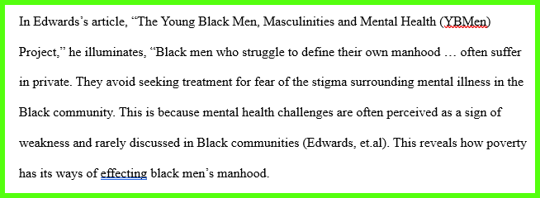
Data: Supports the Writing Process (cont.)
Excerpt From Cavon’s Cause/Effect Essay
Notes:
OER like the Quotation Worksheet are relevant and useful for students, and I was impressed at the transfer I saw as they applied the new knowledge to their work. In his Cause/Effect Essay analyzing the effects of poverty on black men’s sense of manhood, Cavon was able to transfer the principles of effective quotation integration to the passage shown. Students improved at including signal phrases, an in-text citation in MLA format, and a statement following the quote in which they interpreted it for the reader and explained how it helps them support their points.

Slide 18
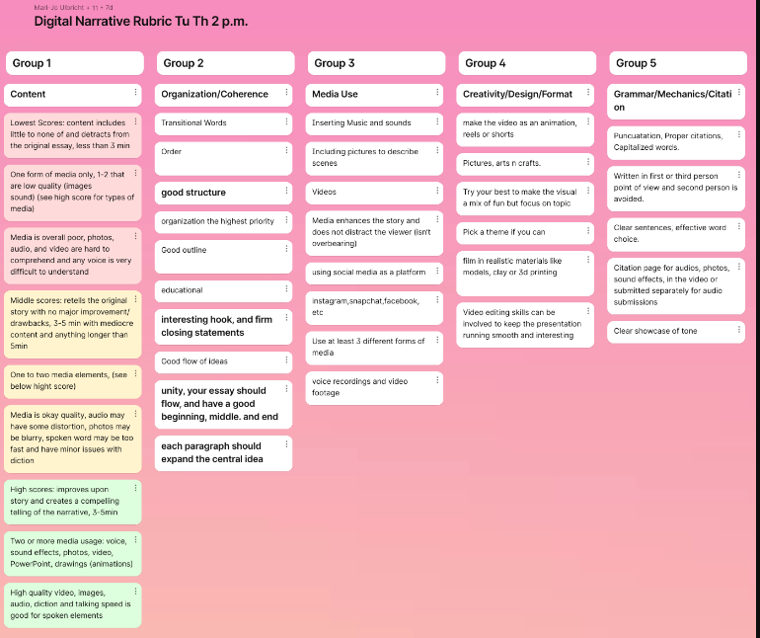
Data: Student-Centered Experience
Notes:
Students were empowered as active contributors. They co-created the rubric for a Digital Narrative OER Commons assignment I reused and revised. Each group generated criteria for 1 of 5 categories (Content, Organization/Coherence, Media Use, Creativity/Originality, and Grammar/Mechanics and Citations) with their comments projected on the screen. I knew they were engaged in this activity when they wanted to comment in other columns as well. This experience facilitated a collaborative dynamic between the students and instructor as co-learners and enabled a role shift where the we shared equal footing in certain aspects, transcending the traditional power dynamic and emphasizing a shared pursuit of knowledge.

Slide 19
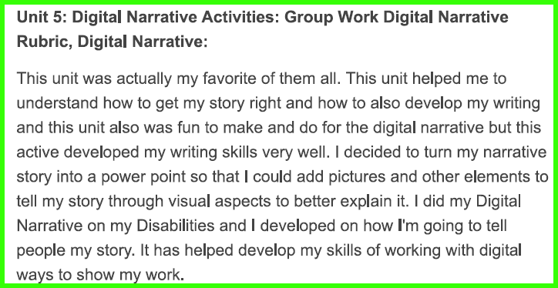
Data: Student-Centered Experience:
Students as Producers
Excerpt From Deja’s Journal re Digital Narrative
Notes:
Implementing OEP with alternative assessments like an OER Digital Narrative is crucial in the first-year HBCU composition class. David Green (2016) suggests these alternatives enable students to express their cultural identities and voices creatively, moving away from rigid writing norms. Incorporating a Digital Narrative exposed students to multimedia storytelling, enhancing their written narratives beyond text. Allowing medium choice taps into their diverse interests, fostering motivation, as seen with Deja.

Slide 20
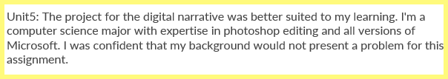
Data: Student-Centered Experience:
Students as Producers (continued)
Excerpt re Digital Narrative From Jason’s Journal
OER/OEP was instrumental in my ability to differentiate writing instruction for a group of diverse learners by addressing their specific learning needs. As beginners, some students availed themselves of the tutorials on creating a slide show presentation, adding narration, and exporting the file as a movie. Yet other students with more experience in various platforms were able to work in any medium they felt comfortable with as Jason pointed out in his journal reflection.
Notes:
This personalized approach enabled them to expand their existing skills and knowledge, building their confidence. As well, tailoring instruction to accommodate students' varying learning styles, abilities, and backgrounds acknowledged and respected their individuality.

Slide 21
Discussion
Significance of Findings
The shift in instruction made possible with OER/OEP emphasizes the role of students as active participants while instructor acts as a facilitator.
Context of Findings
The study filled a gap by examining what pedagogies utilizing OER/OEP look like in one specific setting: a standardized 1st-year composition course at an HBCU.

Slide 22
Implications
Implications for Practice
Further Research
Explore avenues for students to create, remix, and publish OER content, engage with broader communities, and establish global connections.
OEP is on a spectrum spanning from adoption to adaption, creation, and connection (Underhill, 2017).
Achieving the spectrum’s high end is challenging individually. Collaboration and workshops are crucial for faculty awareness and support.
Investigate how OER/OEP may facilitate Culturally Relevant Pedagogy
Examine the evolving role of OER/OEP in a world influenced by AI content generators.
Notes:
Can OER/OEP help instructors to construct meaningful assignments that discourage the use of AI? In the alternative, can it suggest ways to incorporate AI into the curriculum? I would also love to see our department develop our own “OER Repository” for the 1st year composition courses. This would encourage openness and sharing of resources. It would help adjuncts and other faculty who have workload and time constraints. Ideally we could also coordinate our efforts with the librarians so we could leverage their expertise in curating materials from OER repositories that are specifically relevant to the first-year composition course content.

Slide 23
References (continued)
Creswell, J., & Poth, C. (2018). Qualitative Inquiry & Research Design (Fourth). Sage Publications, Inc.
Cronin, C. (2017). Openness and Praxis: Exploring the Use of Open Educational Practices in Higher Education. International Review of Research in Open and Distributed Learning, 18(5), 15–34. http://proxy-su.researchport.umd.edu/login?url=https://search.ebscohost.com/login.aspx?direct=true&db=eric&AN=EJ1152012&site=ehost-live
Freire, P. (1970). Pedagogy of the Oppressed. Seabury Press.
Gile, S. G. (2020). Curriculum Approaches and HBCU Students’ Confidence in Themselves as Writers: Is There a Difference? [Columbia International University]. In ProQuest Dissertations and Theses. http://proxy-su.researchport.umd.edu/login?url=https://www.proquest.com/dissertations-theses/curriculum-approaches-hbcu-students-confidence/docview/2358737571/se-2?accountid=28711
Green, D. F. (2016). Expanding the Dialogue on Writing Assessment at HBCUs: Foundational Assessment Concepts and Legacies of Historically Black Colleges and Universities. College English, 79(2), 152–173. http://www.jstor.org.proxy-su.researchport.umd.edu/stable/44805915
Griffin, K. R., Glushko, T. A., & Liu, D. (2019). Rhetorical awareness of student writers at an HBCU: A study of reflective responses in the writing center. Praxis: A Writing Center Journal, 16(2), 1–14. https://repositories.lib.utexas.edu/handle/2152/75573
Handa, C. P., Dayton, A. M. Y. E., Campbell, N. R., Manora, Y. M., & Schneider, S. A. (2013). FIRST-YEAR WRITING PROGRAMS AT HISTORICALLY BLACK COLLEGES by KEDRA LAVERNE JAMES Submitted in partial fulfillment of the requirements for the degree of Doctor of Philosophy in the Department of English in the Graduate School of The University of Alabama.
Herr, K., & Anderson, G. (2005). The action research dissertation (2nd ed.). Sage Publications.
Hill, C., & Ericsson, P. F. (2014). The Crystal Ball Project: Predicting the Future of Composition and the Preparation of Composition Teachers. The Clearing House: A Journal of Educational Strategies, Issues and Ideas, 87(4), 143–148. https://doi.org/10.1080/00098655.2013.875883
Jin, S. W., Warrener, C., Alhassan, M., & Jones, K. C. (2017a). An empirical assessment of writing and research proficiency in HBCU social work students. Journal of Human Behavior in the Social Environment, 27(5), 463–473. https://doi.org/10.1080/10911359.2016.1203385

Slide 24
References (continued)
Klages, M. A., & Clark, J. E. (2009). New Worlds of Errors and Expectations: Basic Writers and Digital Assumptions. Journal of Basic Writing, 28(1), 32–49. http://search.ebscohost.com/login.aspx?direct=true&db=ufh&AN=44224887&lang=es&site=ehost-live
Kress, G. (2000). Multimodality. Multiliteracies: Literacy learning and the design of social futures, 182-202.
Lee, H. C. (2014). Using an arts-integrated multimodal approach to promote English learning: A case study of two Taiwanese junior college students. English Teaching, 13(2), 55–75. https://doi.org/10.1109/ICACT.2007.358581
Lin, H. (2019). Teaching and Learning Without a Textbook : Undergraduate Student Perceptions of Open Educational Resources. 20(3)
Litterio, L. M. (2018). Uncovering Student Perceptions of a First-Year Online Writing Course. Computers and Composition, 47, 1–13. https://doi.org/https://doi.org/10.1016/j.compcom.2017.12.006
Merriam, S. B., & Tisdell, E. J. (2016). Qualitative Research: A Guide to Design and Implementation (Fourth). Jossey-Bass.
Mitchell, K. L. (2016). Language in the center: A case study of multilingualism in an historically black university writing center. ProQuest Dissertations and Theses, 179. http://0-search.proquest.com.pugwash.lib.warwick.ac.uk/docview/1796055573?accountid=14888%5Cnhttp://webcat.warwick.ac.uk:4550/resserv??genre=dissertations+%26+theses&issn=&title=Language+in+the+center%3A+A+case+study+of+multilingualism+in+an+historically+
Mongillo, G., & Wilder, H. (2012). An Examination of At-Risk College Freshmen’s Expository Literacy Skills Using Interactive Online Writing Activities. Journal of College Reading and Learning, 42(2), 27–50. http://search.ebscohost.com/login.aspx?direct=true&db=eric&AN=EJ972859&site=ehost-live
New London Group. (2000). A pedagogy of multiliteracies: Designing social futures. In B. Cope & M. Kalantzis (Eds.), Multiliteracies: Literacy learning and the design of social futures (pp. 9–38). MacMillan.

Slide 25
References (continued)
Nickoson, L., & Sheridan, M. P. (2012). Writing studies research in practice: Methods and methodologies. Southern Illinois University Press.
Pitts, C. A. (2017). Internationalizing the Curriculum: Re-Thinking Pedagogical Approaches to World Literature and English Composition. International Research and Review, 6(2), 120–139. https://search.proquest.com/docview/2009558591?accountid=10382%0Ahttp://link.library.curtin.edu.au/openurl??url_ver=Z39.88-2004&rft_val_fmt=info:ofi/fmt:kev:mtx:journal&genre=article&sid=ProQ:ProQ%3Aeric&atitle=Internationalizing+the+Curriculum%3A+Re-Thin
Rauch, M. J. (2020). Perceptions of Academic Writing from First Generation Non-Traditional Students. In ProQuest Dissertations and Theses. The University of Mississippi.
Relles, S. R., & Tierney, W. G. (2013). Understanding the Writing Habits of Tomorrow’s Students: Technology and College Readiness. In Journal of Higher Education (Vol. 84, Issue 4). Journal of Higher Education. http://proxy-su.researchport.umd.edu/login?url=https://search.ebscohost.com/login.aspx?direct=true&db=eric&AN=EJ1011667&site=ehost-live
Sagor, Richard., & Williams, C. (2017). The Action Research Guidebook (3rd ed.).
Saldaña, J. (2016). The Coding Manual for Qualitative Researchers. Sage Publications.
Takayoshi, P., & Huot, B. (2009). Composing in a Digital World: The Transition of a Writing Program and Its Faculty. WPA: Writing Program Administration, 32(3), 89–119. http://scholar.google.com/scholar?hl=en&btnG=Search&q=intitle:Composing+in+a+Digital+World:+The+Transition+of+a+Writing+Program+and+Its+Faculty#3
Tillinghast, B. (2020b). Developing an Open Educational Resource and Exploring OER-Enabled Pedagogy in Higher Education. IAFOR Journal of Education, 8(2), 159–174.
Warnock, S., & Gasiewski, D. (2018). Writing Together: Ten Weeks Teaching and Studenting in an Online Writing Course. National Council of Teachers of English.
Weller, M., de los Arcos, B., Farrow, R., Pitt, B., & McAndrew, P. (2015). The Impact of OER on Teaching and Learning Practice. Open Praxis, 7(4), 351–361. https://doi.org/10.5944/openpraxis.7.4.227
Vygotsky, L. S. (1978). Mind in society: The development of higher psychological processes. Harvard University Press.
Yu, E. (2014). Let Developmental Students Shine: Digital Writing. Research & Teaching in Developmental Education, 30(2), 99–110. http://proxy-su.researchport.umd.edu/login?url=https://search.ebscohost.com/login.aspx?direct=true&db=eric&AN=EJ1034064&site=ehost-live

